Slide 1
GeorgiaFIRST Financials
September 13, 2023
Accounts Payable and Travel & Expenses
Birds of a Feather Session
Notes:
Welcome to the GeorgiaFIRST Financials Accounts Payable and Travel & Expenses Birds of a Feather session.
My name is Brooklyn Davis and I have been with ITS since May of 2022 serving as the Travel and Expense Module analyst since then.
(Kistie Introduces herself)
We are so excited to be here and to meet some of you for the first time and a lot of you face to face for the first time.
Birds of a feather sessions are just an informal discussion, an open forum for us to all voice our issues and/or questions related to these two topics.
We have prepared some content to review but, we would like to begin this session by opening the floor to you all to ask us or your peers any questions pertaining to accounts payable or Travel and Expenses.

Slide 2

Accounts Payable & Travel and Expenses
Open Discussion

Slide 3
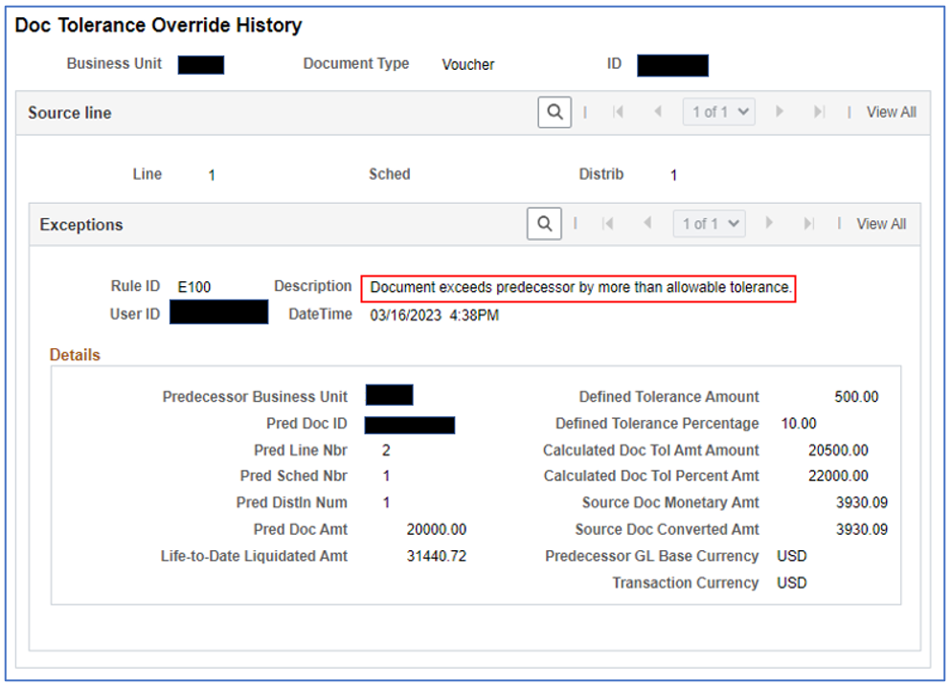
Accounts Payable
Just a reminder to consider the effects of overriding a document tolerance error.
For example: This error referred to the voucher exceeding the purchase order by more than the allowable tolerance.
*Overriding the error caused the PO encumbrance to not liquidate accurately. This line had a split distrib line. The voucher was only applied to one distrib line causing it to exceed the allowance. When additional vouchers were added to the PO, they could not be split according to the distribution on the PO because there was nothing encumbered for the 1st distrib line. The vouchers were tied to the PO, but they did not liquidate the encumbrance accurately.
Notes:
For this particular error, the PO line item had 2 distrib lines.
The 1st voucher entered against the PO was only applied to the first distrib line which caused a doc tol exception because the amount of the voucher exceeded the amount on the PO distrib line it was applied against.
The exception was overridden.
When add’l vouchers were applied to the PO, there was no encumbrance remaining on the 1st distrib line, therefore when the voucher distrib line was split to match the PO, the amount for the 1st distrib line had nothing to liquidate.
The vouchers were tied to the PO, but were not liquidating the encumbrance like they should have.
So, just keep in mind the cause and effect of overriding doc tol errors. They may seem small or not important, but in the big picture, they affect more than just the voucher.

Slide 4
Travel and Expenses
Employee Meals Full Day / Meals Provided Update

Slide 5
Travel and Expenses
What’s Different?
The PeopleSoft Expense Module will calculate the correct reimbursement amount for employees who have meals provided on their first and last day of travel.
To accomplish this, the procedure to claim meal per diems will begin with claiming the full day meals option, no matter what day of travel then adding a new line for a meal that was provided using our new ‘meals provided’ expense types.
Let’s look at how this will work with the new meals provided expense types.

Slide 6

Accounts Payable
Match Exceptions and the Relationship Between Purchasing and AP
Matching is the process used to compare Vouchers with Purchase Orders and, when required, with Receipts to ensure that your institution pays for only the goods and services that have been ordered and received.
Two-Way Match: Voucher and Purchase Order
Three-Way Match: Voucher, Purchase Order and Receipt
Decisions made by one department can affect the other. Communication
is important to resolve Match Exceptions the right way.
Notes:
Let’s review the relationship between Purchasing and AP.
On our website, we have a full recorded matching presentation where Teresa discusses both the purchasing side and the AP side in much more detail.
Read Slide

Slide 7


Accounts Payable
Accounts Payable Responsibilities
Understand what a Match Exception means before deciding to override it and what the effect will be if the choice is to override.
If necessary, request for the Purchasing Dept to adjust the PO Match requirements and/or Receiving settings.
Notes:
The first step to make when encountering a Match Exception is to stop and consider the effects of overriding the exception.
With most matching overrides, the PO will not be eligible to be closed and the purchasing dept will have to force close it. This is one of the reason why we stress that communication between AP & Purchasing is key to avoiding unnecessary confusion.
Most time, you can avoid having to override the exception by working with the purchasing dept to either adjust the match and/or receiving requirements, having the receiver enter a receipt, etc.
If you ever have any questions about the type of exception or the effects of overriding it, please let us know.

Slide 8
Accounts Payable
To Override or Not to Override?
PO Line set to Receiving Required
No receipt exists
Notes:
Let’s take a look at a few scenarios…
Read slide
What is the best way to handle this exception?

Slide 9
Accounts Payable
To Override or Not to Override?
Do not override this Match Exception if a receipt should be created.
Determine:
  Is it an item or a service? Asset?
  Has the quantity/amount that you are vouchering been physically received?
Ask the Purchasing Department to update the Receiving Requirement on the Purchase Order if it is incorrect so that you do not have to override the exception. Communication is key to avoid paying for something you don’t yet have.
If this type of Match Exception is overridden, the PO will NOT be eligible to be closed. The Purchasing dept will have to manually force it to close.
Notes:
Read slide

Slide 10
Accounts Payable
To Override or Not to Override?
PO Qty = 5
Voucher Qty = 5
Receiving Required, but No Receipt created
What are 2 ways to resolve this exception without overriding it?
Notes:
Read slide

Slide 11
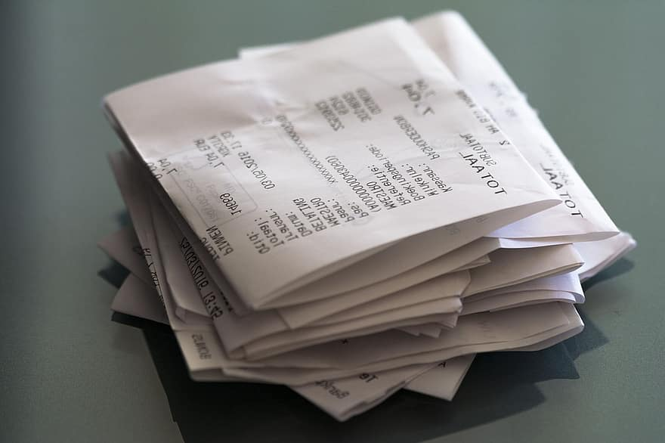
Accounts Payable
To Override or Not to Override?
If you override this exception, the PO Status will get updated to Matched, as expected.
However, the PO will NOT be eligible to be closed. The Purchasing dept will have to manually force it to close.
It is OK to leave a voucher with a Match Status of Exceptions. Once a receipt is created the voucher will be matched when the matching
process is run.
Notes:
Read Slide

Slide 12
Accounts Payable
To Override or Not to Override?
PO Qty = 5, PO Unit Price = $20.00
Voucher Qty = 5, Voucher Unit Price = $17.00 (Invoice came in with a lower unit price)
Receiving NOT Required
What is the best way to resolve this Match Exception?
Notes:
Read Slide

Slide 13
Accounts Payable
To Override or Not to Override?
This Match Exception will most likely require some research to determine the best way to resolve. The first thing to do is confirm you copied in the correct PO.
Confirm the final invoice amount is correct.
If you determine that the final invoice price is correct and is less than the PO price, it is ok to override this Match Exception.
The PO Match Status is updated to MATCHED, since the full quantity was vouchered.
The PO WILL be eligible to be closed, without further intervention.
Notes:
Read slide

Slide 14
Accounts Payable
To Override or Not to Override?
PO Line Amount: $31.40
Voucher Line Amount: $6.28
Previously Vouchered Line Amount: $31.40
What is the best way to resolve this Match Exception?
Notes:
Read Slide

Slide 15
Accounts Payable
To Override or Not to Override?
This Match Exception will most likely require some research in order to determine the best way to resolve.
These Match Exceptions are telling us:
  The voucher amount does not equal the PO amount.
  The voucher amount EXCEEDS the PO tolerance amount ($500 or 10%) because the full amount of the PO line was previously vouchered.
Determine if there is a valid reason for exceeding the PO amount.
Choose which action to take – Override, Correct the voucher amount, or Close/Delete the voucher if it is a duplicate.
The PO will NOT be eligible to be closed and will need to be force closed.

Slide 16
Accounts Payable
To Override or Not to Override?
PO is for an Asset
Receiving is Required, but no receipt exists
What is the best way to resolve this Match Exception?
Notes:
This is our last scenario
Read Slide

Slide 17
Accounts Payable
To Override or Not to Override?
This Match Exception cannot be overridden.
Ask Purchasing/Receiving to create a receipt if the item has been physically received OR wait for a receipt to be created.
It is OK to leave a voucher with a Match Status of Exceptions. Once a receipt is created the voucher will be matched when the matching process is run.
Notes:
Read Slide

Slide 18
Travel and Expenses
Creating an Expense Report from an approved Travel Authorization Demonstration
Notes:
-Using FPRC1
-Log in as ITS_BDAVIS1
-Navigate to Classic/ Create an expense report
-Copy from approved Travel authorization
-Update my milage on the Emp Mileage T1 lines
-Deduct 25% from my first and last day of travel
-Click on the Quick Fill option to add all meals provided for the week
-Update payment method on each line
-Verify my lines contain the proper accounting details
-*Touch on Hotel Wizard if you didn’t add a separate line for Parking*
-Add Attachments / for food, gas and hotel
-Summary and submit
-Acknowledgment
-View pending approval
-complete

Slide 19
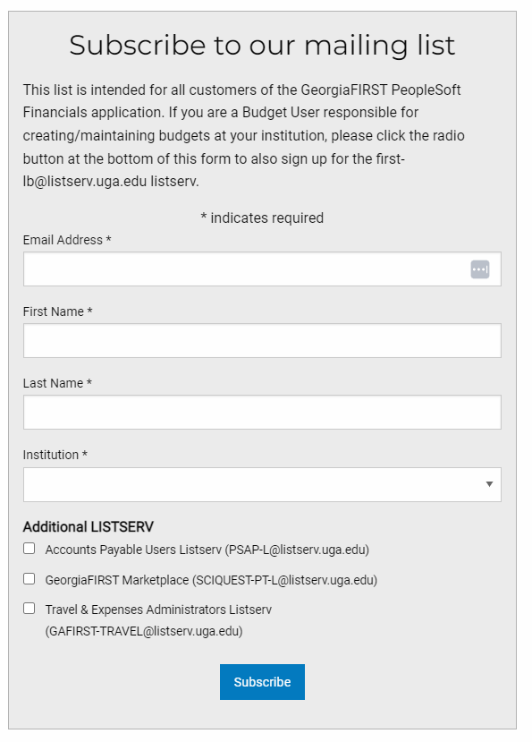
GeorgiaFIRST Communications
Users are encouraged to subscribe to GeorgiaFIRST communications via Mailchimp announcements and listservs here.
Notes:
Subscribe to GaFIRST Financials List Serv to receive all the current updates and changes related to the Travel and Expense module

Slide 20
Accounts Payable & Travel and Expenses
Open Discussion

Slide 21


37 days
22 days
8 days
32 days
32 days

Slide 22



