Slide 1
GeorgiaFIRST Financials
Birds of a Feather Session
Kristi Bradshaw
Sherrie Moon
Kelly Saxon
September 13, 2023

Slide 2
Agenda
GeorgiaFIRST Website
Update of PeopleSoft Interface
Adding a Lease
Reversal Journals
Simple Journal Functionality
Questions

Slide 3
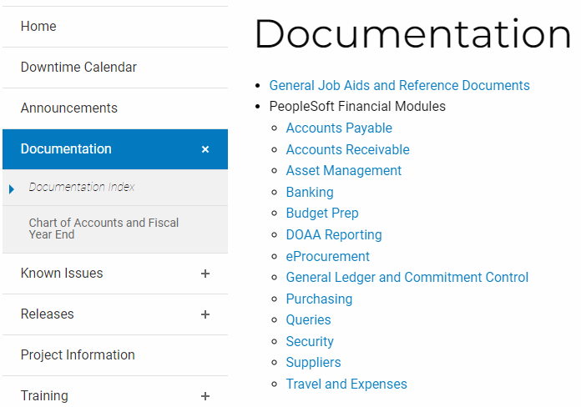
GeorgiaFIRST Website
https://www.usg.edu/gafirst-fin/
All PeopleSoft Financials Business Processes, Job Aids, and Reference Documents are located on the Documentation Index page.

Slide 4
Annual Maintenance Release 5.90
GeorgiaFIRST Financials In the Know Session:
October 12th 10:30 am

Slide 5
User Interface Changes
Current Home Page
New Home Page

Slide 6
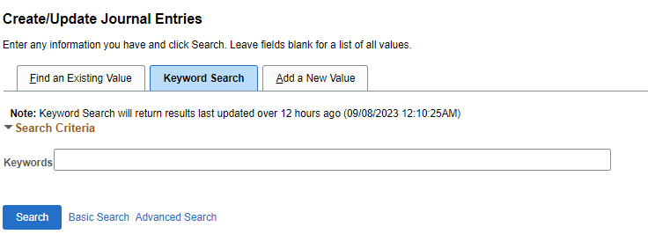
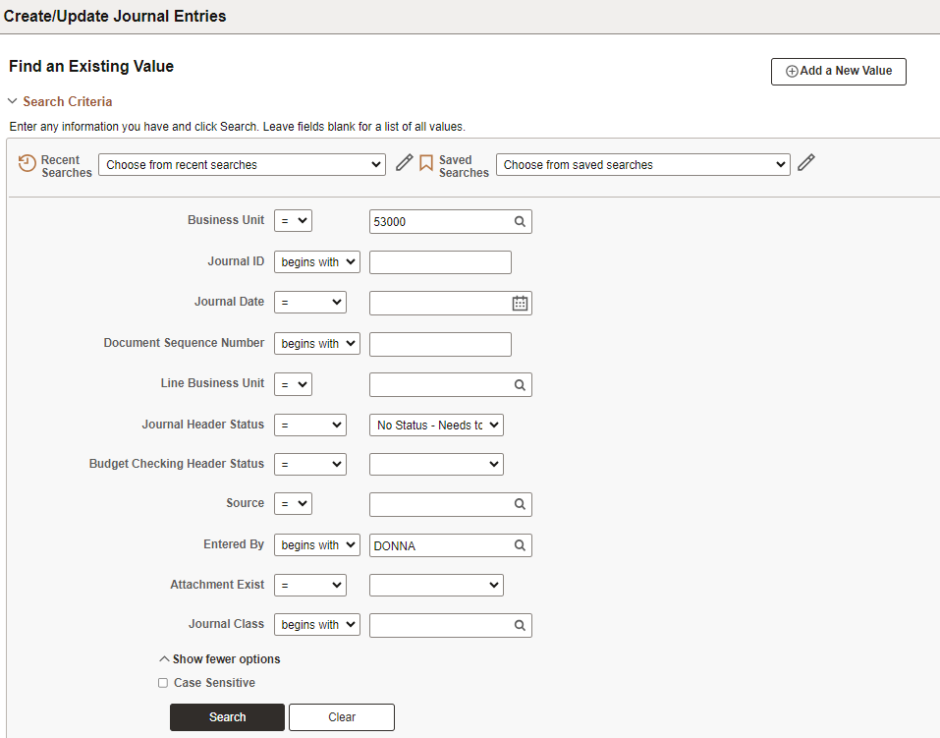
Keyword Search
Current Journal Entry Page
New Journal Entry Page

Slide 7
Questions

Slide 8
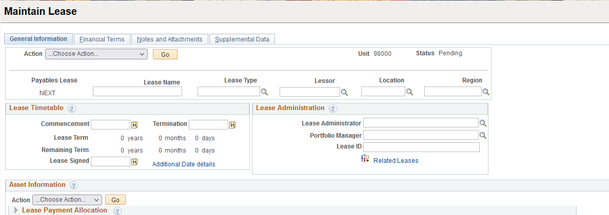
Asset Management
How to enter a Lease: Business Process AM.020.075-Adding a Lease
Navigation: Asset Management>Asset Transaction> Leased Asset>Create New Payables Lease

Slide 9
Lease Example
Entering a Lease in GeorgiaFIRST Financials
General Information Tab
The commencement date and the termination date should align with the term.
Amortization should calculate for the term.
07/01/2023 – 6/30/2026

Slide 10
Lease Example cont
Select the appropriate profile ID based on characterization and term of the lease.
For leases that do not transfer ownership, the profile and category should begin with an “L.” SBITAs should be categorized with an “S” category.

Slide 11
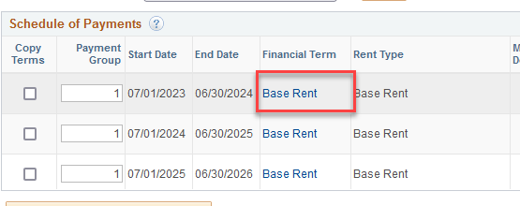
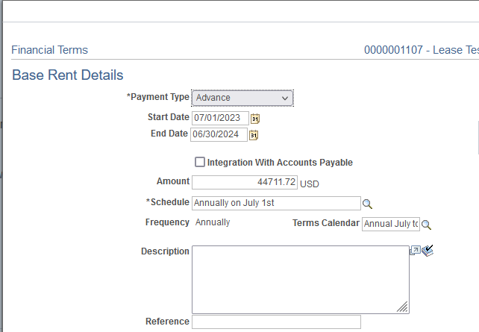
Lease Example cont.
-Financial Terms Tab – Base Rent hyperlink
In the below screenshot, the payment type is “Advance” to obtain the correct payment schedule.
The start and end date should align with the payment schedule.

Slide 12
Lease Example cont.
Financial Terms Tab – Preview Payment Schedule hyperlink.
Preview Payment Schedule hyperlink to ensure you do not have extra Schedule dates.

Slide 13
Lease Example cont.
Verify Total Lease Payments, PVLP and ROU Asset Cost before activating the lease:

Slide 14
Questions

Slide 15
General Ledger
1. Automatic Reversal Journals
2. Simple Journals Functionality
Notes:
-For the General Ledger module, I’d like to talk to you about Automatic Reversal Journals and Simple Journals Functionality.

Slide 16
Automatic Reversal Journals
Automatic Reversal Journals
Typically used for year-end journal entries
Cannot be edited or deleted
Header Info
Entered By: will reflect user id of user who approved the original journal entry
Entered On: will reflect the date the original journal was approved
Notes:
-Automatic Reversal Journals
-They are typically used for year-end journal entries
-We’ve had a few instances within the last 6 months or so where the original journals are unposted prior to the automatic reversal journal posting. This causes some issues that I’ll talk about on the next slide.
-Just a couple of things to know about Automatic Reversal Journals:
-They cannot be edited or deleted
-On the journal header page, the Entered By will reflect the user id of the user who approved the original journal entry and
-the Entered On will reflect the date the original journal was approved

Slide 17
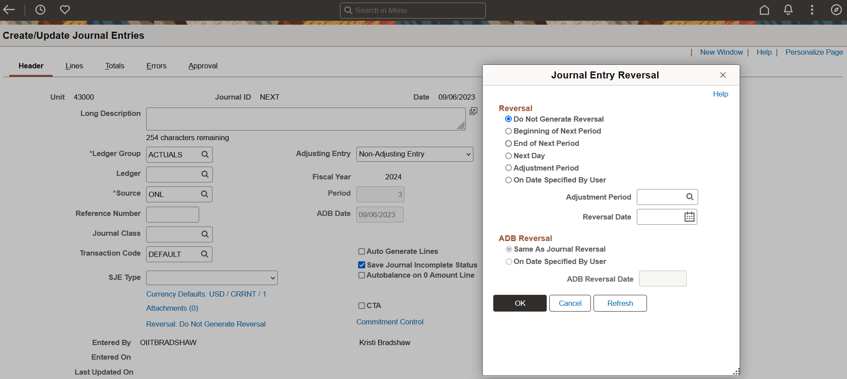
Automatic Reversal Journals
Notes:
Here is a screenshot showing what we just discussed if you’re not familiar with automatic reversal journals.
Beside the red arrow, is the link you would click to set up the automatic reversal journal.

Slide 18
Automatic Reversal Journals
Do not unpost the original journal entry prior to the automatic reversal journal entry being posted.
This has historically caused amounts not to back out of Commitment Control which in turn causes out of balance issues.
This has also caused journals to become stuck in an Incomplete Posting status.
Both of these can cause inaccurate reporting for your institution.
If you find that the original journal entry is incorrect after it is posted, but prior to the automatic reversal journal posting, please submit a ticket to ITS.
Notes:
-Please do not unpost the original journal entry prior to the automatic reversal journal being posted.
-This has historically caused amounts not to back out of commitment control which in turn causes out of balance issues.
-This has also caused the journals to become stuck in an Incomplete Posting status.
-and both of these can cause inaccurate reporting for your institution.
-If you find that the original journal entry is incorrect after it is posted but prior to the automatic reversal journal posting, please submit a ticket to ITS for guidance on how to handle.

Slide 19
Simple Journals
Simple Journals:
New functionality for users
KSU is piloting after the fall release
Global roll out to all institutions will be spring 2024
Notes:
-The next topic is Simple Journals
-This is new functionality that we plan to roll out to all Business Units in the Spring.
-There is no change to the existing delivered journal processing.
-KSU will pilot this functionality for us after the annual maintenance release this November.

Slide 20
Simple Journals
Simplifies data entry from an end-user standpoint
Automates the billing of services from one department to another within the institution
Users will define templates and workflow for intercompany transactions
Minimum workflow required will be one department approver and overall journal approver
Notes:
-Currently general ledger & commitment control does not have many, if any, Fluid pages. The pages for Simple Journals are Fluid.
-We’re currently system testing these pages and hopefully with KSU piloting and our continued testing we’ll have it running smoothly by the Spring roll out
-What are Simple Journals used for or the Point of Simple Journals:
-To simplify data entry from an end-user standpoint
-To automate billing services between departments within the institution
-Access to Simple Journals can be distributed out to the departments where you would not do that for regular journals
-They’re used to define templates and workflow for intercompany transactions
-Administrators will define the templates.
-Workflow at a minimum will be 1 department approver and an overall journal approver (this is your GL journal approvers).
-Additional levels of approval are available (2nd dept approver and 2 project approvers)
-There are separate security roles for Simple Journal entry and approval

Slide 21
Simple Journals
Users will access the page through the Finance & Accounting Home Page Simple Journal tile.
Notes:
-The next few slides are some screenshots of Simple Journal entry pages.
-Here, this one shows the Simple Journal tile.
-It is accessed through the Finance & Accounting Home Page.

Slide 22
Simple Journals
Notes:
This example illustrates what the page looks like when adding a new journal.

Slide 23
Simple Journals
Notes:
-The required information for a simple journal is on the left and data entry is on the right.
-This is an example of the journal header page.
-If you’ll notice , the first 3 fields are grayed out. Administrators can configure the fields that appear on the Journal Entry pages for users.

Slide 24
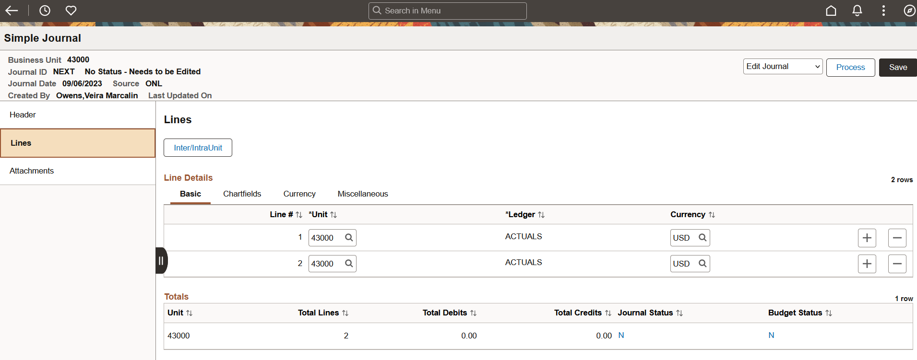
Simple Journals
Notes:
-This is a screenshot of the lines page.
-The pages for Simple Journals will look different b/c of them being Fluid.
-On a regular journal, all of the fields are on one tab whereas for Simple journals there are 4 tabs – Basic, Chartfieds, Currency, and Miscellaneous.
-Again, Administrators can configure the fields that appear on the pages.

Slide 25
Simple Journals
Users can process the journal with same options as a regular journal entry.
Notes:
As shown here, users can process the journal with the same options as a regular journal entry.

Slide 26
Simple Journals
Simple Journals will be optional functionality for institutions. Institutions can choose to implement or continue with their defined process to account for these transactions.
Notes:
-Once the functionality is rolled out in the spring, each institution may choose to implement this functionality or continue their defined process to account for these transactions.

Slide 27
Questions
Notes:
-And that’s all we have.
-Are there any questions?

Slide 28
37 days
22 days
8 days
32 days
32 days

