Slide 1
Housekeeping
All participants muted upon entry
If calling in via phone, please do not put the call on hold
Session is being recorded
Use the chat feature for questions
Questions will be sent out with answers after the meeting

Slide 2
Using Chat
•Chat will also be monitored
– = “we see this and are working on it”
– = “thanks, this has been addressed”

Slide 3
1099 Withholding Information
December 10, 2020 @ 10:00AM
Jonathan Hemphill

Slide 4
Agenda
IRS 1099 Withholding Changes for 2020
1099 Withholding Amounts for CY2020
PeopleSoft 1099 Withholding Updates for 2020
Updating Suppliers, Vouchers, Withholding Transactions
1099 Withholding Processes Review
Withhold 1099 Report Job
IRS_001_%.TXT File
Copy B files
Queries and Reports
Important Dates
Resources

Slide 5
IRS 1099 Withholding Changes for 2020

Slide 6
IRS Changes
The IRS changed its reporting methods for 1099 Withholding for the 2020 Reporting Calendar Year. There will now be two withholding forms:
New Form: 1099-NEC
Beginning with tax year 2020, will be used to report nonemployee compensation
This form will be used instead of 1099-MISC, Box 7 (Withholding Class 07)
NEW TYPE/CLASS: Nonemployee Compensation – 1099N, Class 01
Redesigned Form: 1099-MISC
Due to the creation of Form 1099-NEC, the IRS revised form 1099-MISC and rearranged box numbers for reporting certain income
Classes that have changed: 07, 09, 10, 12, 14
More information about these changes can be found on the IRS website here.

Slide 7
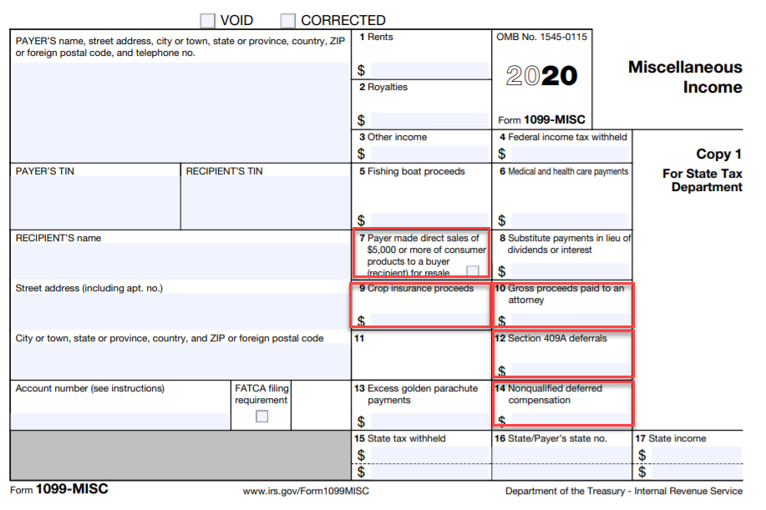
1099-MISC Form Changes
IRS provided a new 1099-MISC Form with updated wording on instructions
Based on current information in our system, the only class (not including NEC) used by institutions that will change is:
Gross Proceeds Paid to an Attorney
Prior to CY 2020: 1099-MISC, Class 14
CY 2020 – Future: 1099-MISC, Class 10
7
Notes:
Dave

Slide 8
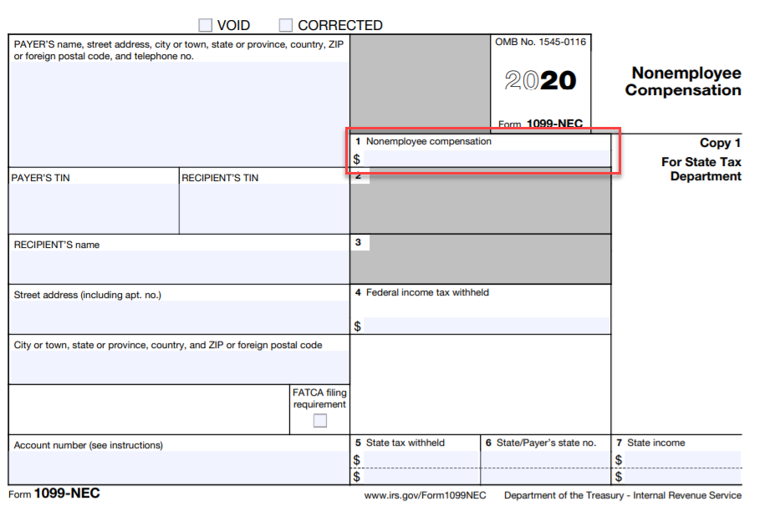
New 1099-NEC Form
IRS provided a new 1099-NEC Form & Instructions
NEW FORM FOR REPORTING:
Non-employee Compensation
Prior to CY 2020: 1099-MISC, Class 07
CY 2020 - future: 1099-NEC, Class 01
8
Notes:
Dave

Slide 9
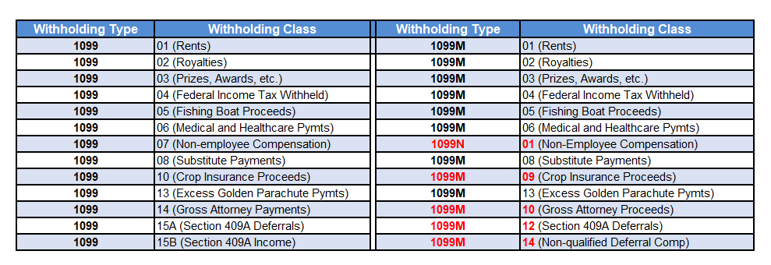
IRS Withholding Type and Class Conversion
Prior to CY2020
CY2020
*1099 Class 42 (Non-Resident Alien Withholding) is not available in the new 1099N or 1099M classes. If the institution uses this category, please submit a ticket to helpdesk@usg.edu, explaining need/use.

Slide 10
DEMO
DEMO – Show new Types/Classes Options in PeopleSoft for a NEW Withholding Supplier

Slide 11
Review and Questions
Recap:
there will be two CopyB forms for CY2020. One called 1099-MISC and another that is 1099-NEC.
we will no longer use the 1099 Withholding Type. We will only use 1099N or 1099M Type for withholding suppliers.
Non-Employee Compensation (NEC) income will be reported as Withholding Type 1099N, Class 01. (Previously this was 1099 Type, Class 07)
Gross Attorney Proceeds will be Withholding Type 1099M, Class 10. (Previously this was 1099 Type, Class 14.)
Any other questions at this point?

Slide 12
1099 Withholding Amounts for CY2020

Slide 13
1099 Withholding Amounts for CY2020
Withholding Type | Withholding Class | Description | Paid at least:
1099N | 01 | Non-Employee Compensation | $600.00
1099N | 04 | Federal Income Tax Withheld | $0.00
1099M | 01 | Rents | $600.00
1099M | 02 | Royalties | $10.00
1099M | 03 | Prizes, Awards, etc. | $600.00
1099M | 04 | Federal Income Tax Withheld | $0.00
1099M | 05 | Fishing Boat Proceeds | $600.00
1099M | 06 | Medical and Health Care Payments | $600.00
1099M | 08 | Substitute Payments | $10.00
1099M | 09 | Crop Insurance Proceeds | $600.00
1099M | 10 | Gross Attorney Proceeds | $600.00
1099M | 12A | Section 409A Deferrals | $600.00
1099M | 13 | Excess Golden Parachute Payments | $0.00
1099M | 14 | Non-qualified Deferred Compensation | $600.00

Slide 14
PeopleSoft (Oracle) 1099 Withholding Updates for 2020

Slide 15
Oracle Bug 31114646
New Withholding Types/Classes/Categories added into FPROD – Applied November 2020
Only provide ‘RPT’ as Withholding Category – Applied November 2020
Suppliers - New Withholding Types/Classes must be added to ALL (active/inactive) existing suppliers – Applied December 8, 2020
Vouchers (Paid) – All Paid vouchers for 1/1/2020-12/31/2020 must be updated with New Withholding Types/Classes – Scheduled December 15, 2020
Vouchers (Unpaid) – All Unpaid vouchers for 1/1/2020-12/31/2020 must be updated with New Withholding Types/Classes – Scheduled December 15, 2020
Oracle Bug 31903172 (NOV2020)
Release 5.62 - Oracle 1099 Update App Engine/New 1099 Forms (Nov. 13) – Scheduled December 18, 2020
Oracle Bug 32166779 (NOV2020)
Release 5.62 - 1099 Additional Update to change layout of 1099-NEC Form (Released on Nov. 25) – Scheduled December 18, 2020

Slide 16
What will these changes affect?
Supplier Withholding
Voucher Withholding (Unpaid and Paid Vouchers)
IRS Withholding Reporting for CY2020 Processing

Slide 17
Updating Suppliers, Vouchers, Withholding Transactions

Slide 18
What has ITS completed in anticipation of these changes?
ITS added 1099N and 1099M Withholding Types and Classes as Withholding Options for Suppliers and Vouchers – Applied November 2020
ITS added 1099N and 1099M Supplier Category of ‘RPT’ – Applied November 2020
Note: HOLD and WTHD, which were available with previous 1099 Type, will no longer be available options with 1099N and 1099M Withholding Types. All previous 1099 Supplier Categories of HOLD and WTHD were changed to RPT.

Slide 19
What will ITS complete in anticipation of these changes?
Update all Suppliers withholding information to reflect the new 1099N or 1099M Withholding Types/Classes – Applied December 8th
Update all Paid Vouchers to withholding suppliers with the new 1099N or 1099M Withholding Types/Classes – December 15th
Update all Unpaid Vouchers to withholding suppliers with new 1099N or 1099M Withholding Types/Classes – December 15th
Institutions will not have to do this manually.

Slide 20
Review and Questions
Recap
we will no longer use the 1099 Type. We will only use 1099N or 1099M Type for withholding suppliers.
the Supplier Categories of WTHD & HLD will not be available for 1099M and 1099N Types. There will only be RPT Supplier Category.
you will not need to manually update all Previous suppliers in the system.
you will not have to update paid and unpaid vouchers in the system prior to Dec. 15th.
you will need to make sure to only use the NEW withholding types/classes on suppliers vouchers after Dec. 8th
Any other questions at this point?

Slide 21
What will institutions need to do?
Only use 1099N and 1099M Withholding Types/Classes when creating/updating NEW Withholding Suppliers (after Dec. 1, 2020)
Only use 1099N and 1099M Withholding Types/Classes For Supplier & Voucher Withholding Options (after Dec. 8, 2020)
DO NOT delete the old 1099 Withholding Type from Suppliers
This must stay in system in case there are IRS corrections for Withholding Reporting years prior to CY2020.
Starting today, ITS recommends institutions enter NEW Withholding Suppliers with the NEW Withholding Types and Classes (1099M & 1099N).
Starting today, ITS recommends institutions enter NEW Withholding Vouchers with the NEW Withholding Types and Classes (1099M & 1099N) available for the supplier.

Slide 22
Review and Questions
Recap:
we will only use 1099N and 1099M Withholding Types/Classes For Withholding Suppliers.
we will only use 1099N and 1099M Withholding Types/Classes For Voucher Withholding Options.
you SHOULD NOT delete the old 1099 Withholding Type from Suppliers because:
This must stay in system in case there are IRS corrections for Withholding Reporting years prior to CY2020.
you should make sure any of your unpaid withholding vouchers have the correct withholding type and class before paying.
Starting today, ITS recommends institutions enter NEW Withholding Suppliers and NEW withholding vouchers with the NEW Withholding Types and Classes (1099M & 1099N).
Any other questions at this point?

Slide 23
Entering 1099 Withholding Supplier Information for CY2020
Process has not changed
Beginning CY2020, multiple 1099N and 1099M Types/Classes can be used for a single Supplier
The old 1099 Withholding Type is still an option; however it should not be used for NEW Withholding Suppliers.
This Withholding Type must remain in system in case of IRS corrections for previous years’ 1099 Withholding Reporting

Slide 24
IMPORTANT
DO NOT use the old 1099 Withholding Type for Suppliers created/updated in CY2020 or beyond. If used, the Withholding reporting to IRS will be incorrect.
DO NOT delete the old 1099 Withholding Type from Suppliers.

Slide 25
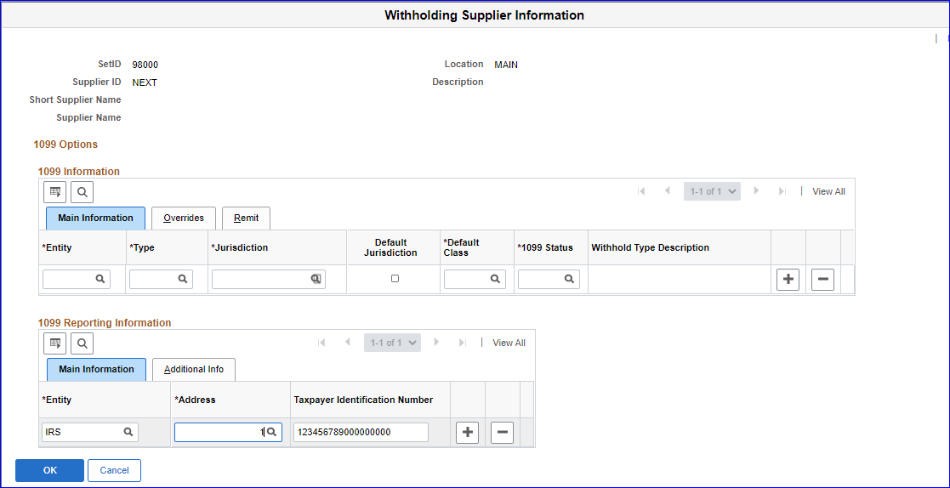
How to Update 1099 Withholding Information - Suppliers
Navigation: Suppliers > Supplier Information > Add/Update > Supplier > Open/Add Supplier > Location Tab > Click on 1099 link on Withholding Location

Slide 26
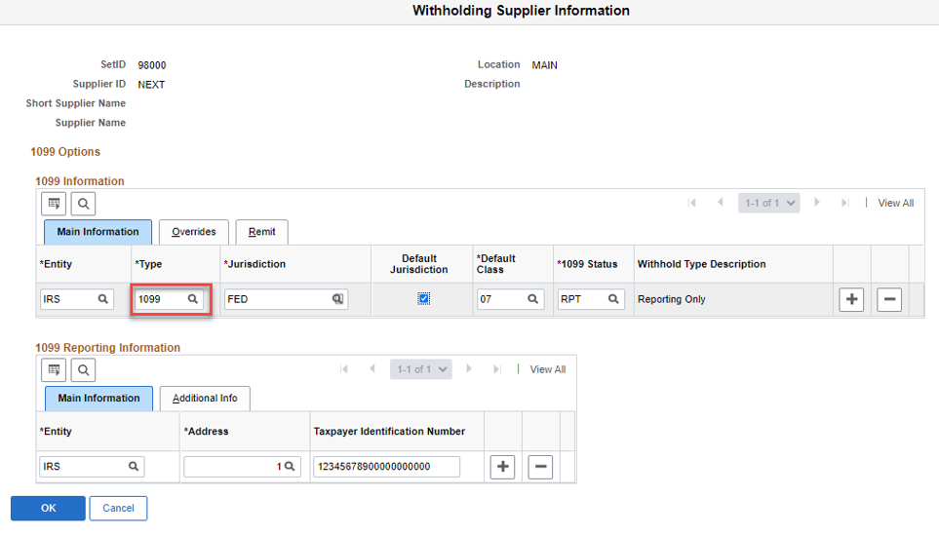
Prior to CY2020, users would choose ‘1099’ as the Withholding Type on the Withholding Supplier Information page.

Slide 27
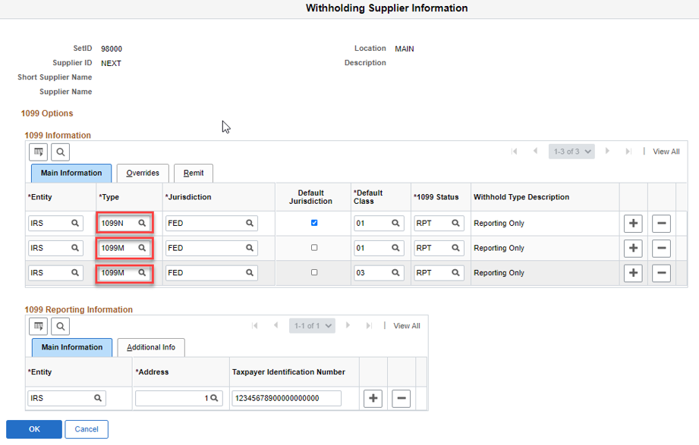
For CY2020 and beyond, users will choose ‘1099N’ and/or ‘1099M’ as the Withholding Types

Slide 28
Review and Questions
Recap:
we will only use 1099N and 1099M Withholding Types/Classes For NEW Withholding Suppliers.
DO NOT use the old 1099 Withholding Type for NEW Suppliers because your IRS reports will not be correct for CY2020 and beyond.
Any other questions at this point?

Slide 29
What will users see after ITS updates Suppliers?
Users will see the Old Withholding Types/Classes
Example: Type 1099, Class 07
This must remain to keep data accurate for previous years’ withholdings.
AND users will see the new corresponding Withholding Types and Classes
Example: 1099N, Class 01
Users will see that the New corresponding Withholding Type is now the “Default Jurisdiction”

Slide 30
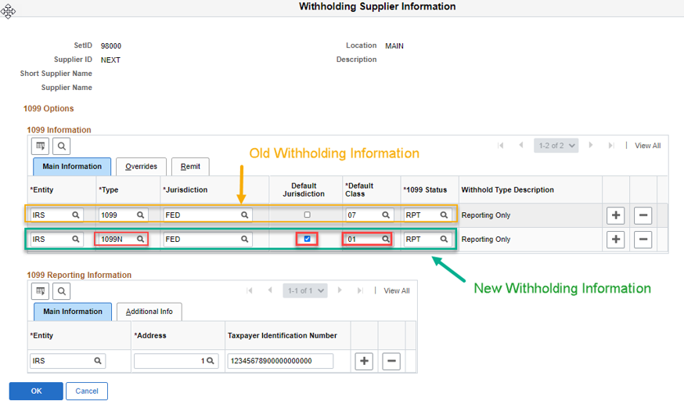
Example: After ITS Updates 1099 Supplier Currently in System

Slide 31
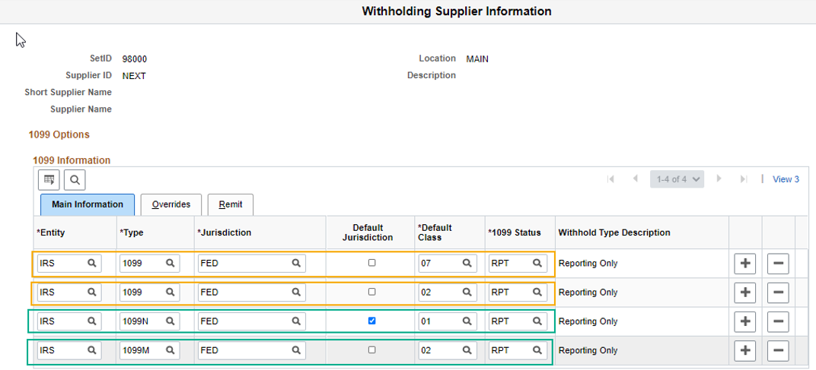
Example: Multiple Withholding Conversions

Slide 32
Example: Multiple withholding conversions AND a new class added after ITS conversion.
Note: You do not have to add a corresponding 1099 Type line for anything CY2020 or after.

Slide 33
DEMO
DEMO – Show Suppliers after ITS update
DEMO – Show Supplier after ITS update with additional NEW Withholding Type Class

Slide 34
Review and Questions
Recap:
we will only use 1099N and 1099M Withholding Types/Classes For NEW Withholding Suppliers.
DO NOT use the old 1099 Withholding Type for NEW Suppliers because your IRS reports will not be correct for CY2020 and beyond.
DO NOT delete the old 1099 Withholding Type from Suppliers if you see it.
you may see a variety of 1099, 1099-N, 1099-M Types on a Supplier’s Withholding Options.
Any other questions at this point?

Slide 35
How to Update 1099 Withholding Information - Vouchers
Process has not changed
Multiple 1099N and 1099M Types/Classes can be used for separate Distribution Lines
NOTE: The old 1099 Withholding Type is still an option; however you will not select it for vouchers in CY2020 and beyond.
The old 1099 Withholding Type must remain in system in case of IRS corrections for previous years’ 1099 Withholding Reporting

Slide 36
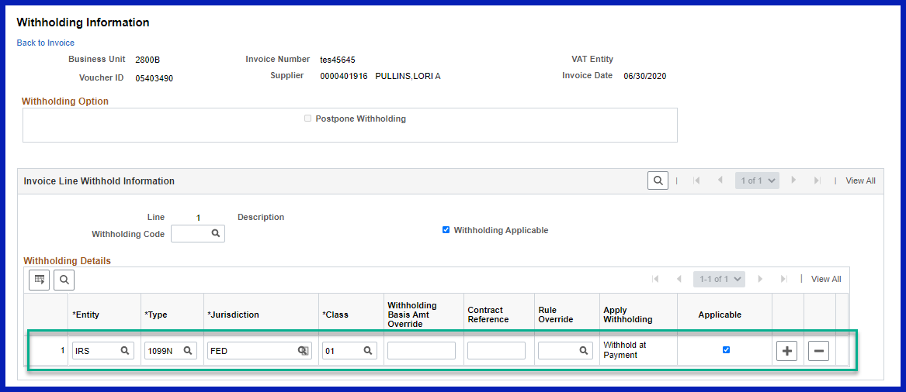
Navigation: Accounts Payable> Vouchers > Add/Update > Regular Entry > Add/Search for Voucher > On Invoice information tab, click Withholding Link
Make sure to choose the correct 1099N or 1099M Withholding Type/Class.

Slide 37
DEMO
DEMO – Show modifying Withholding Information on a voucher for a withholding supplier with the new 1099N/1099M Types

Slide 38
IMPORTANT
DO NOT use the old 1099 Withholding Type for vouchers created/updated in CY2020 or beyond. If used, the Withholding reporting to IRS will be incorrect.
DO NOT delete the old 1099 Withholding Type from Suppliers.

Slide 39
Review and Questions
Recap:
even though the old 1099 Withholding Type is an option for Vouchers, you should not choose it for any NEW vouchers for CY2020 and beyond.
Any other questions at this point?

Slide 40
1099 Withholding Process Review

Slide 41
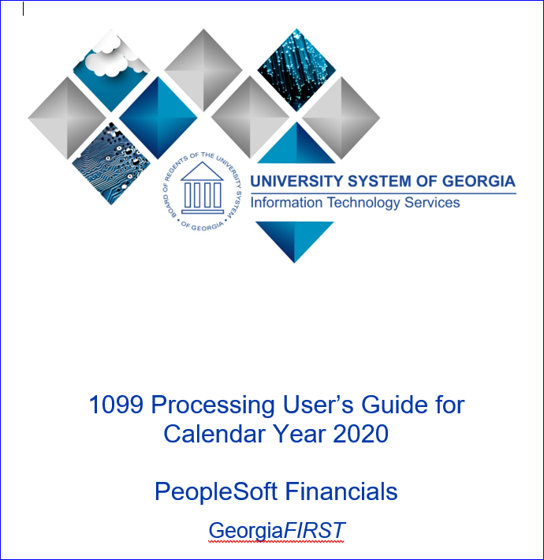
1099 Processing User’s Guide for CY2020
GAFirst Website > Documentation > Documentation Index > Accounts Payable > Business Processes > 1099 Processing User’s Guide for CY2020
https://www.usg.edu/gafirst-fin/documentation/category/accounts_payable

Slide 42
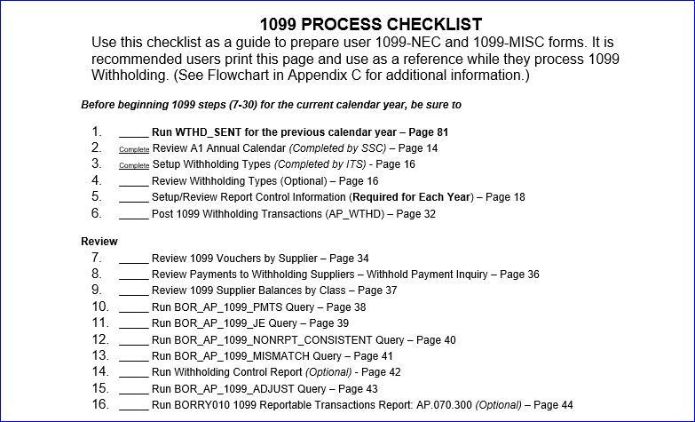
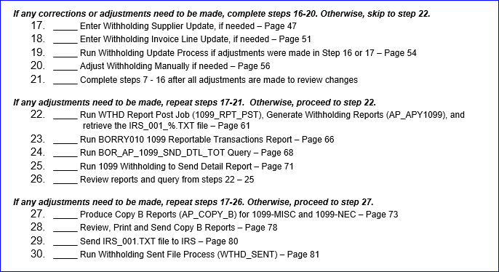
1099 Process Checklist
*Recommended to use the Checklist on Page 5 of the 1099 Processing User’s Guide for CY2020

Slide 43
1099 Processing Overview
IMPORTANT: Confirm Withholding Sent was run for PREVIOUS year**
Setup/Review New Report Control Information for CY2020 (Examples: CSU_2020, UNG_2020, KSU_2020, etc.)
Pay Withholding Vouchers for CY2020
Post Withholding Transactions (AP_WTHD)
Review 1099 Withholding Vouchers/Payments
Adjust 1099 Withholdings as needed
Run Withholding Update Process
Run Withholding Post Job
Review 1099 Withholding to Send Detail Reports
Run Withhold 1099 Report Job to produce Copy B Reports (AP_COPY_B)
Send File to IRS (only one file this year)
IMPORTANT: After IRS accepts, run Withholding Sent Process for CURRENT year**
**This process should be run immediately after the IRS accepts your Original IRS Tax file. If not, it causes issues with Replacement and Correction Files. As well, it can affect the current year’s processing.
Please refer to the 1099 Processing User’s Guide for CY2020 for more detailed information – December 10th

Slide 44
Run Withholding Sent Process
**DO THIS NOW FOR 2019 BEFORE STARTING 2020 PROCESSING**
This process finalizes the 1099 reporting and file creation process. It records all the data in the file you have sent. Do not run this process until after sending the file to the IRS. You can only run it once for each time you run the withholding report. The system uses this information when creating correction or replacement files.
Run this process after the IRS accepts:
Original IRS file
Correction File(s)
Replacement File(s) (Run WTHD_SENT process twice for replacements.)

Slide 45
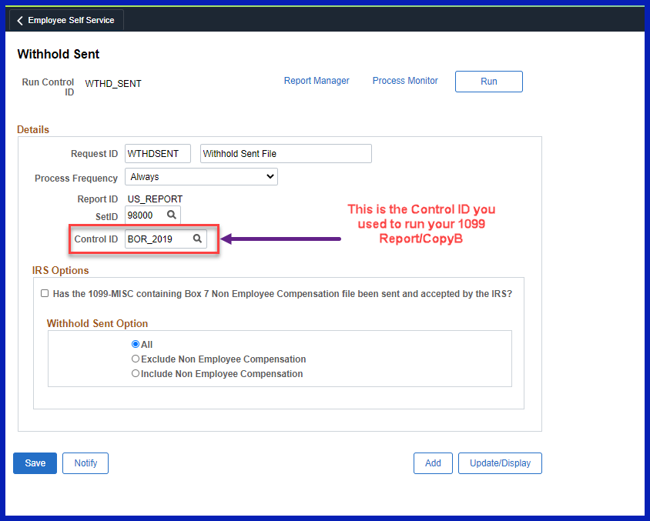
Navigation: Suppliers > 1099/Global Withholding > 1099 Reports > Withholding Sent File

Slide 46
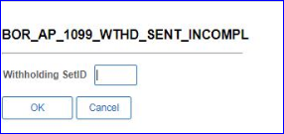
**NEW QUERY** Available Now
BOR_AP_1099_WTHD_SENT_INCOMPL
This query will provide you a list of any Control ID/Reporting Year combinations that are still awaiting the WTHD_SENT process to be run.

Slide 47
DEMO
DEMO – Show how to run the WTHD_SENT Process
DEMO – Show how to run the BOR_AP_1099_WTHD_SENT_INCOMPL query

Slide 48
Review and Questions
Recap
run the WTHD_SENT process after you submit your original file to the IRS and it has been accepted.
run the WTHD_SENT process after you submit a correction file to the IRS and it has been accepted.
run the WTHD_SENT process TWICE after you submit a replacement file to the IRS and it has been accepted.
there is a new query, BOR_AP_1099_WTHD_SENT_INCOMPL, that you can run to find out if you have run the WTHD_SENT process for the following year(s).
Any other questions at this point?

Slide 49
Withhold 1099 Report Job – IRS_%.txt file

Slide 50
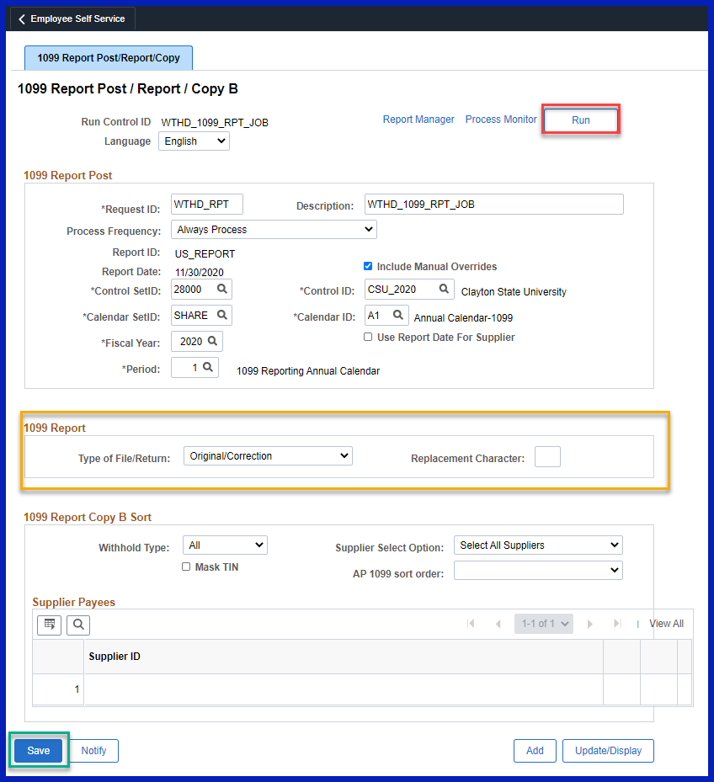
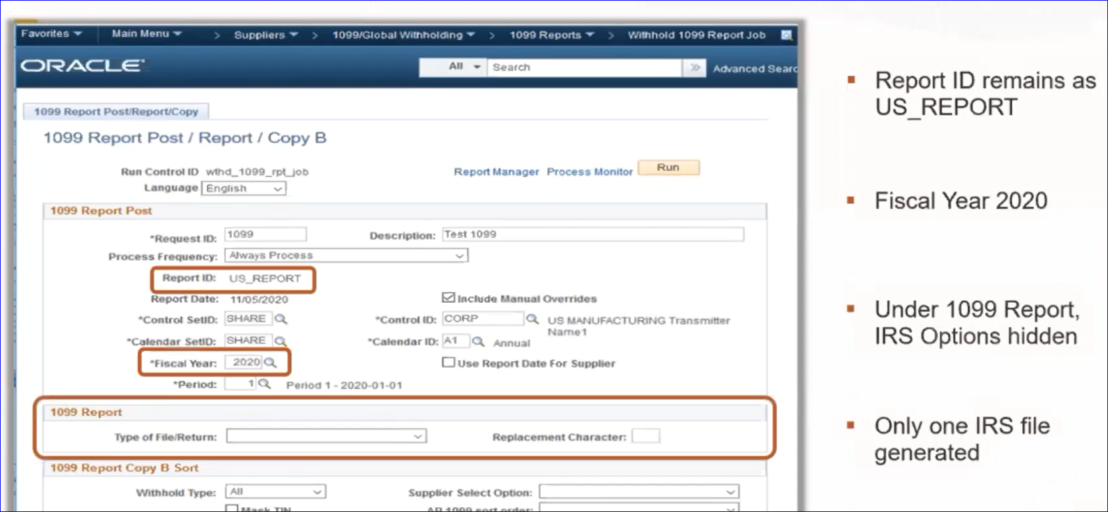
New Change: Withhold 1099 Report Job – CY2020
Navigation: Suppliers > 1099/Global Withholding > 1099 Reports > Withhold 1099 Report Job

Slide 51
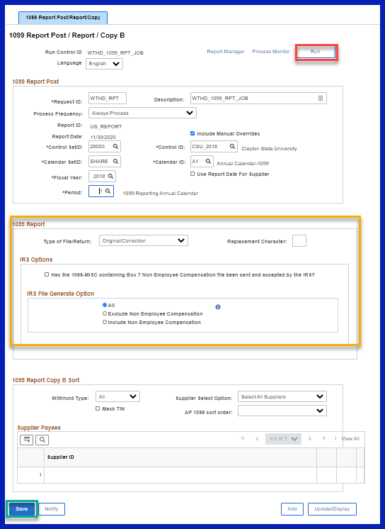
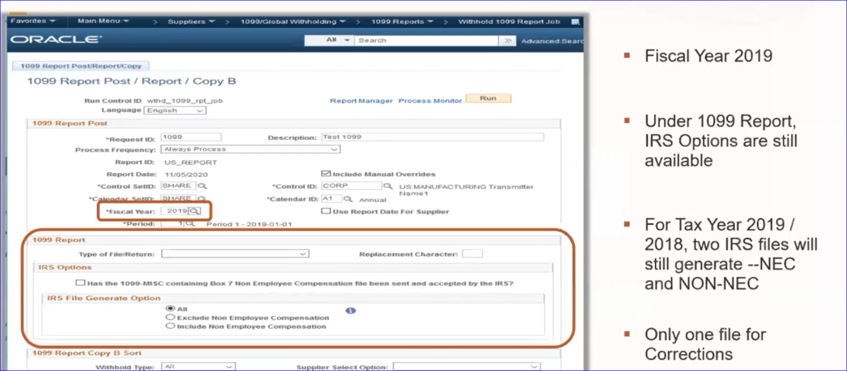
PREVIOUS YEARS: Withhold 1099 Report Job

Slide 52
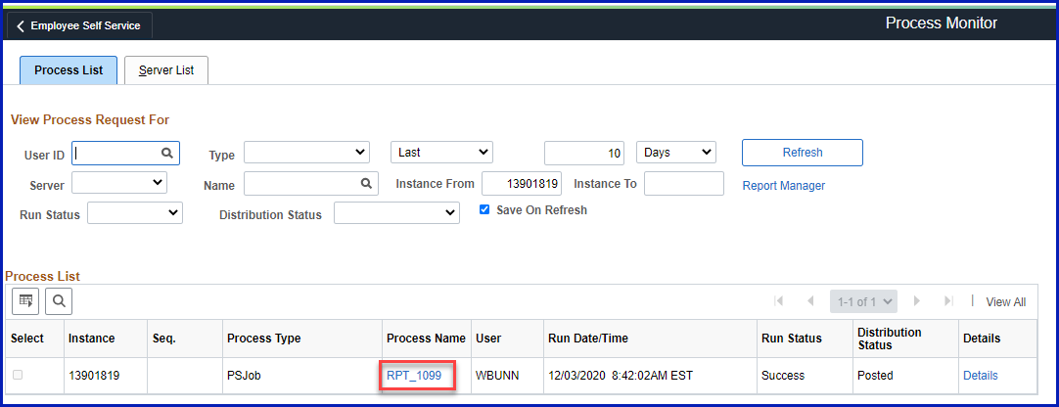
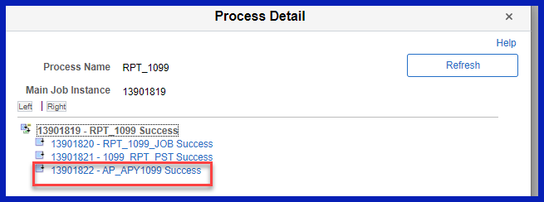
New Change: IRS_001_%.TXT File for CY2020
CY2020: There will only be one file created for CY2020 when you run the 1099 Report Job.
Last year it created a separate file for both NEC and MISC.)

Slide 53
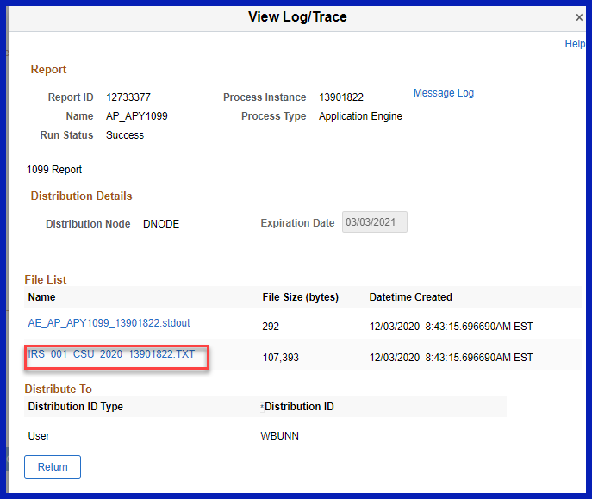
New Change: IRS_001_%.TXT File for CY2020
This file contains all 1099N and 1099M reporting that institutions will submit to the IRS.
Right-click on the IRS_001_%.TXT link and select “Save Link As.”
Save the file to the computer.
Do not Change the file name.
Do not open the file in Excel.

Slide 54
DEMO
DEMO – Show the 1099 Report Job for CY2020
DEMO – Show the 1099 Report Job for CY2019 (different options)
DEMO – Show navigation to the IRS Text File

Slide 55
Review and Questions
Recap:
the 1099 Report Job will only produce one file for the IRS for CY2020.
how to locate the file: IRS_001_%.TXT.
Any other questions at this point?

Slide 56
Withhold 1099 Report Job – COPY Bs

Slide 57
New Change: Print Copy B Files 1099-MISC AND 1099-NEC
Navigation: Suppliers > 1099/Global Withholding > 1099 Reports > Withhold 1099 Report Job
This process will produce two files for CY2020:
APX1099CT-APX1099CT.pdf (1099-MISC CopyB’s)
APX1099N-APX1099N.pdf (1099-NEC CopyB’s)

Slide 58
PRODUCING 1099 COPY B REPORTS
For CY2020 and beyond, there are no choices for separating NEC and MISC:

Slide 59
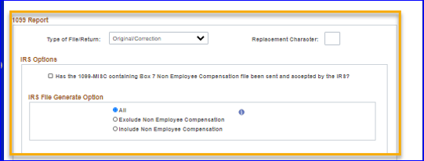
PRODUCING 1099 COPY B REPORTS
For CY2019 and before, there are options for separating NEC and MISC:

Slide 60
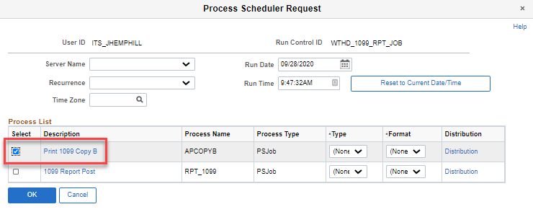
PRODUCING 1099 COPY B REPORTS
Process is the same:
Click the Run button.
Click the check box for the Print 1099 Copy B. Click OK to continue. The system navigates to the 1099 Report Post/Report/Copy B page.
Click the Process Monitor link.
Use the Process Monitor to verify the process runs to Success.

Slide 61
PRODUCING 1099 COPY B REPORTS
Review and Print 1099 Copy B Reports
Navigate to the Report Manager (Report tools > Report Manager)
Click on the Administration tab.
For the 1099-MISC Copy B’s, click on APX1099CT - APX1099CT.pdf link. Download the pdf file and save to a secure location.
For the 1099-NEC Copy B’s, click on APX1099N - APX1099N.pdf link. Download the pdf file and save to a secure location.

Slide 62
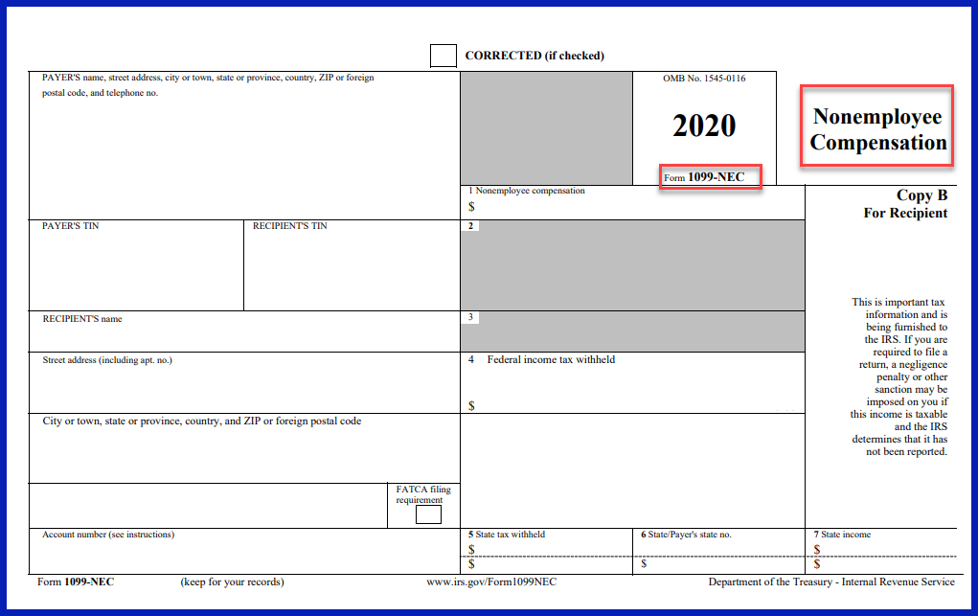
PRODUCING 1099 COPY B REPORTS
Example: 1099-NEC Copy B

Slide 63
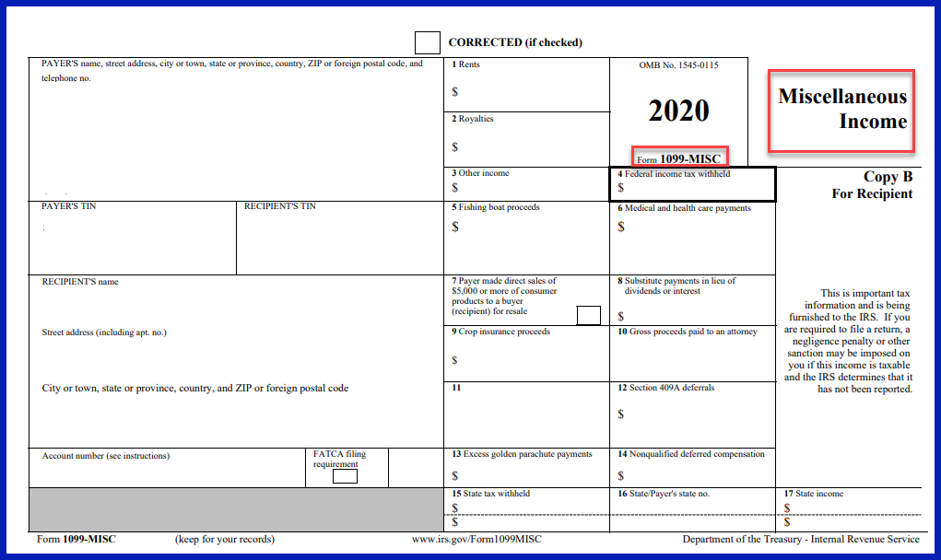
PRODUCING 1099 COPY B REPORTS
Example: 1099-MISC Copy B

Slide 64
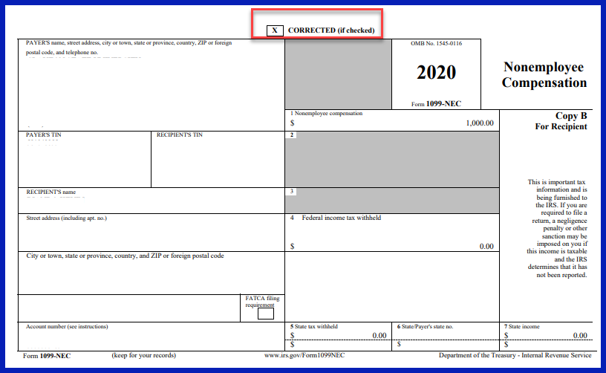
PRODUCING 1099 COPY B REPORTS
Example: Corrected 1099-NEC Copy B

Slide 65
DEMO
DEMO – Show navigation to create/print COPY B Files
DEMO – Show new forms

Slide 66
Review and Questions
Recap:
when you run the 1099 Copy B process, it will produce two files:
APX1099CT-APX1099CT.pdf (1099-MISC CopyB’s)
APX1099N-APX1099N.pdf (1099-NEC CopyB’s)
one file is for 1099-MISC Copy B forms and the other file is for 1099-NEC Copy B forms
Any other questions at this point?

Slide 67
Queries and Reports

Slide 68
1099 Withholding Queries & Reports
1099 Withhold to Send Detail Report (APX8056.pdf) from Oracle does not show the Withholding Type (Per Oracle, working as designed.)
Updated BORRY010 Report to reflect Withholding Types (1099M/1099N). Functionality is the same. – ETA January 1, 2021
Updated 1099 Queries to reflect Withholding Types (1099M/1099N), where applicable. Functionality is the same.
Look for NEW Query: BOR_AP_1099_WTHD_SENT_INCOMPL– Available Now
This query will provide a list of Control IDs/Fiscal Years that need the WTHD_SENT process to be run to finalize the information sent to the IRS.

Slide 69
RUNNING 1099 Withhold to Send Detail Report
Navigation: Suppliers > 1099/Global Withholding > 1099 Reports > 1099 to Send Detail
The Withhold to Send Detail Report (APX8056.pdf) is produced in PDF format and is a replica of the data included in the IRS_001.TXT file.
NOTE: This is an Oracle produced report and it does not include the Withholding Type (1099M or 1099N) in the report. You can read the description to distinguish between 1099N, Class 01 and 1099M, Class 01.
According to Oracle, this is working as designed.

Slide 70
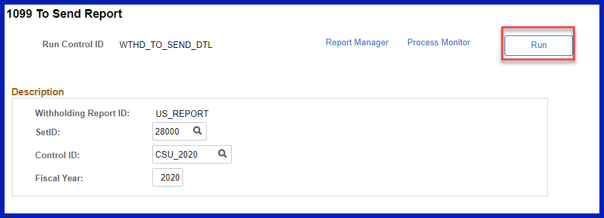
RUNNING 1099 Withhold to Send Detail Report
For CY2020 and beyond, there are no choices for separating NEC and MISC:

Slide 71
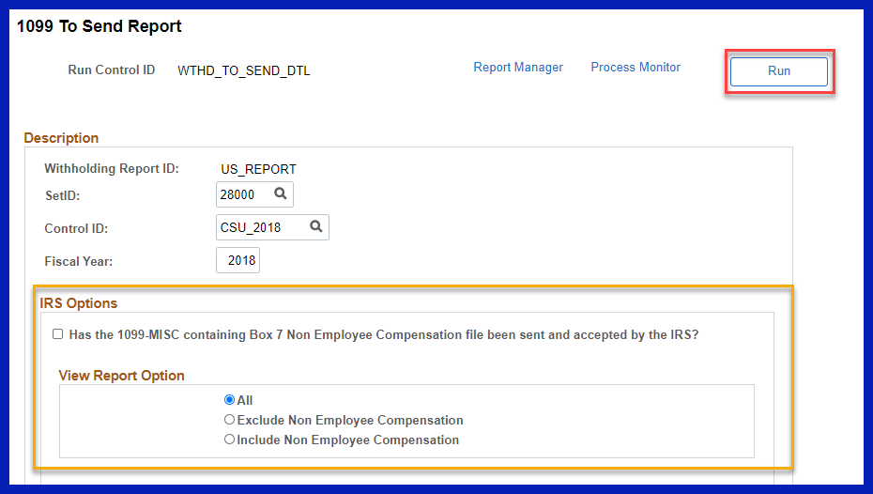
RUNNING 1099 Withhold to Send Detail Report
For CY2019 and before, there are options for separating NEC and MISC:

Slide 72
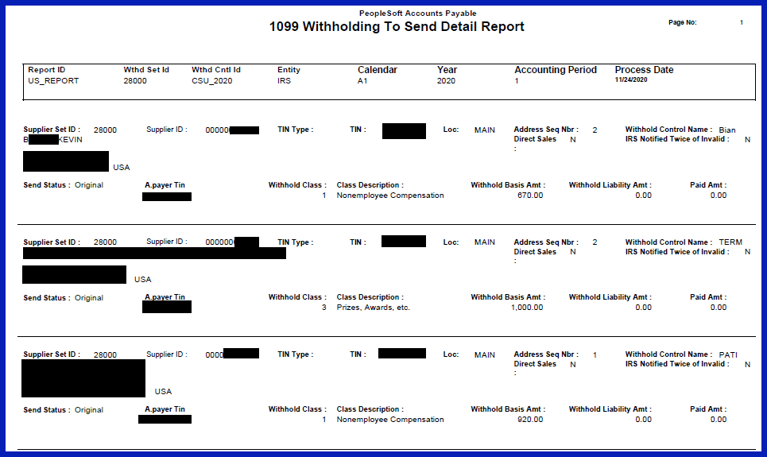
RUNNING 1099 Withhold to Send Detail Report

Slide 73
BORRY010 – 1099 Reportable Transactions
Navigation: BOR Menus > BOR Accounts Payable > BOR AP Reports > 1099 Reportable Transactions
Users can run this report to show all 1099 reportable transactions, including adjustments. When running this report, the data available are dependent on when the user runs the report.
Changes: Now reflects the new Withholding Types (1099M and 1099N)

Slide 74
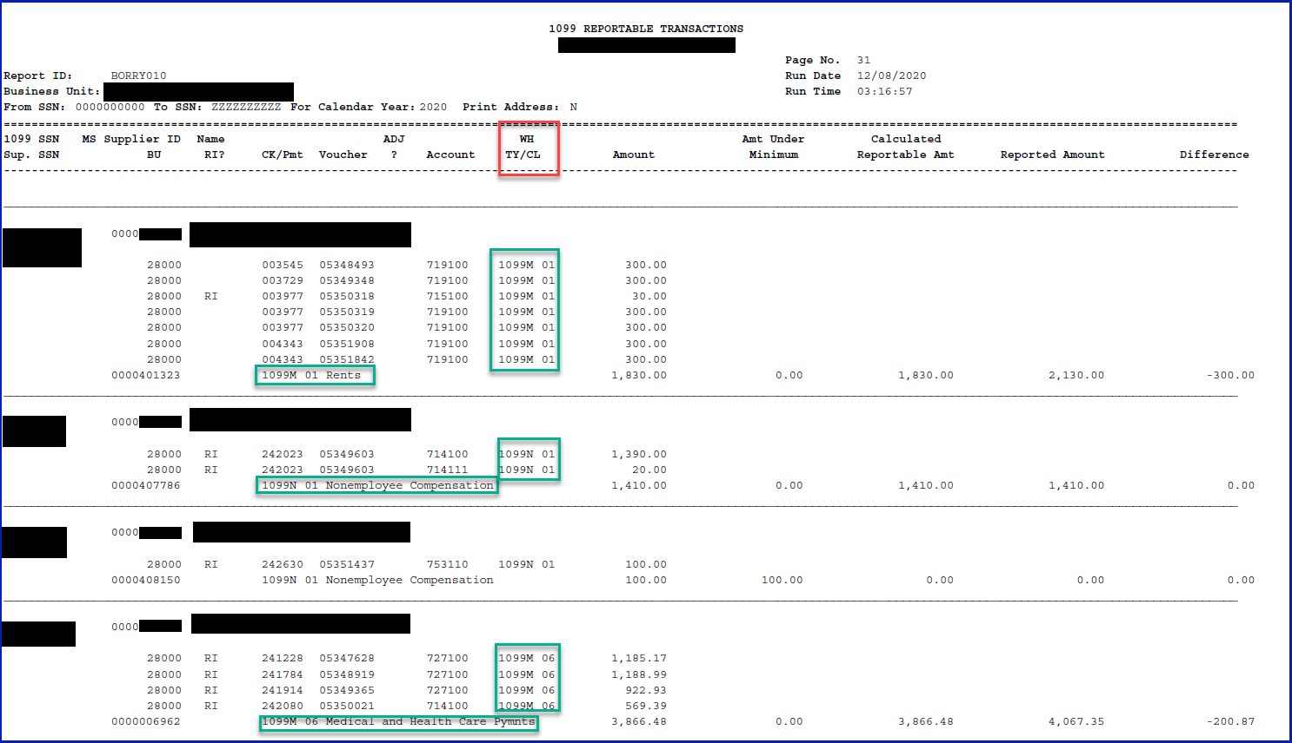
BORRY010 – 1099 Reportable Transactions
Example:

Slide 75
BORRY010 – 1099 Reportable Transactions
Example:

Slide 76
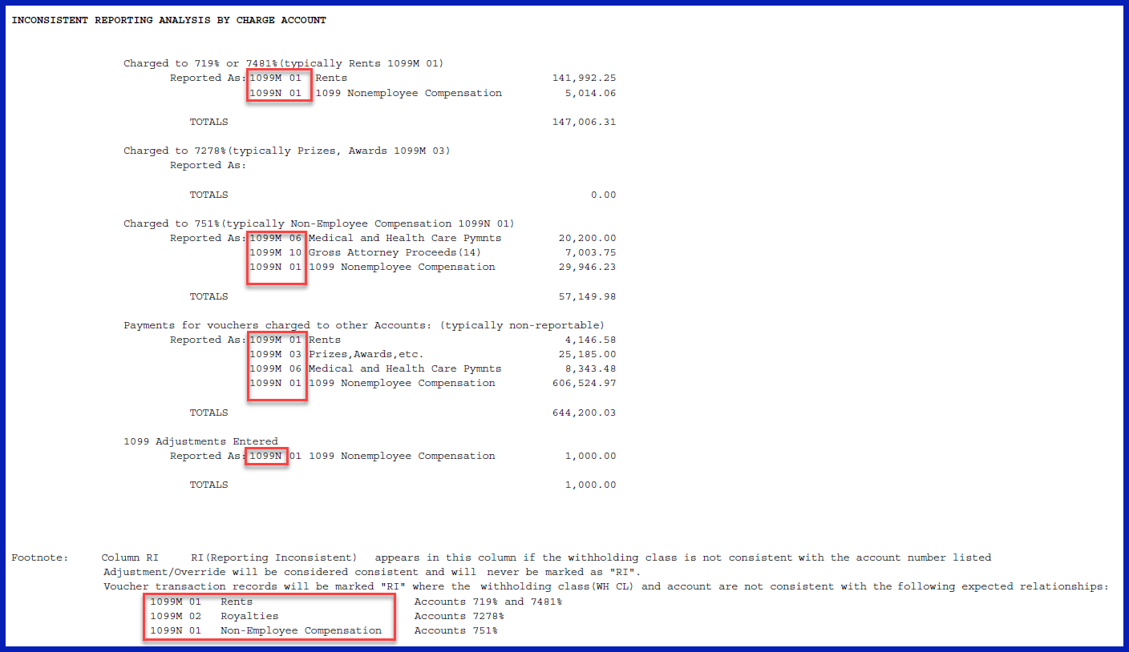
BORRY010 – 1099 Reportable Transactions
Example:

Slide 77
Review and Questions
Recap:
the Withhold to Send Detail Report (APX8056.pdf) an Oracle produced report and it does not include the Withholding Type (1099M or 1099N) in the report.
Work-around: read the description next to the Class to distinguish between 1099N, Class 01 and 1099M, Class 01.
BORRY010 Report will be updated to show the Withholding Types (1099N/1099M) – January 1, 2021
Look for NEW Query: BOR_AP_1099_WTHD_SENT_INCOMPL– Now Available
This query will provide a list of Control IDs/Fiscal Years that need the WTHD_SENT process to be run to finalize the information sent to the IRS.
Any other questions at this point?

Slide 78
1099 Withholding Updates – Important Dates
Date | Item
Today (December 10) | 1099 Withholding Informational Session
Today (December 10) | BOR_AP_1099_WTHD_SENT_INCOMPL query available
Today (December 10) | Start entering NEW Withholding Suppliers with the NEW Withholding Types/Classes
Today (December 10) | Start entering NEW Withholding Vouchers with the NEW Withholding Types/Classes
December 15, 2020 | 1099 Withholding Updates Applied to Paid and Unpaid Vouchers
December 18, 2020 | 1099 Oracle Withholding Updates Applied to Production – Release 5.62
December 18, 2020 | 1099 Oracle Withholding Additional Update – Release 5.62
January 1, 2021 | BORRY010 Report (NEW) will be available
January 31, 2021 | 1099-MISC/1099-NEC Filing with IRS for CY2020

Slide 79
Resources

Slide 80
Recording of Today’s Meeting
PowerPoint Presentation:
GAFirst Website > Documentation > AP > Job Aids and Reference Documents
Recording:
GAFirst Website > Documentation > AP > Training
1099 User’s Guide CY2020:
GAFirst Website > Documentation > Documentation Index > Accounts Payable > Business Processes
https://www.usg.edu/gafirst-fin/documentation/category/accounts_payable

Slide 81
IRS Resources
Internal Revenue Service
Website: www.irs.gov
Phone: 1-866-455-7438
E-mail: irs.e-helpmail@irs.gov
Publication 1220 (Rev. 9-2020) Catalog Number 61275P https://www.irs.gov/pub/irs-pdf/p1220.pdf
2020 Instructions for Forms 1099-MISC and 1099-NEC: https://www.irs.gov/pub/irs-pdf/i1099msc.pdf

Slide 82
ITS Resources
GeorgiaFIRST Financials Website: https://www.usg.edu/gafirst-fin/
AP Documentation: https://www.usg.edu/gafirst-fin/documentation/category/accounts_payable
1099 Processing user’s Guide for CY 2020 – https://www.usg.edu/gafirst-fin/documentation/category/accounts_payable
Accounts Payable (AP) Payment Requests and Vouchers .zip file
AP.020.040 – Entering 1099 Withholding Vouchers
Supplier Documentation: https://www.usg.edu/gafirst-fin/documentation/category/suppliers
Suppliers (SP) Adding Suppliers .zip file
SP.020.010 – Adding a New Supplier
SP.020.030 – Adding 1099 Information to a Supplier
Support E-mail: helpdesk@usg.edu
Publication 1220 (Rev. 9-2020) https://www.irs.gov/pub/irs-pdf/p1220.pdf
2020 Instructions for Forms 1099-MISC and 1099-NEC: https://www.irs.gov/pub/irs-pdf/i1099msc.pdf

Slide 83
Questions?
83

Slide 84
37 days
22 days
8 days
32 days
32 days

