Slide 1
Interacting with PeopleSoft Travel & Expenses
Kate Smith and Kristi Bradshaw
Information Technology Services

Slide 2
Travel and Expense Support
Kate Smith
Kate joined ITS in 2012 supporting the Travel and Expense module and is transitioning to the General Ledger and Commitment Control modules. Prior to joining ITS, she served in various roles in consumer banking and college administration. Kate received a Bachelor of Arts degree in Business Administration from Piedmont College.
Kristi Bradshaw
Kristi has been employed with ITS for over 3 years. She has supported the General Ledger and Commitment Control modules and is transitioning to the Travel and Expense module. Prior to joining ITS, Kristi spent over 20 years in the banking industry, serving in various roles.

Slide 3
Annual Maintenance Release 5.40 Updates
Introducing Classic Plus pages
Hybrid between existing Classic and Fluid
Classic Plus present throughout Travel and Expenses
Slightly different look but same page layout

Slide 4
New Classic Plus Pages – Create Travel Authorization
Classic Classic Plus
Notes:
Note the new Reference field… this field has been present on Expense Reports for some time. We do not use the Reference field, so just leave it blank.

Slide 5
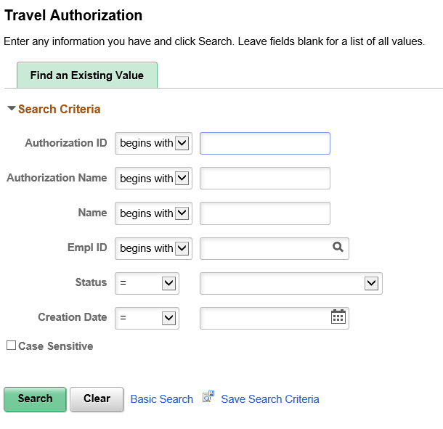
New Classic Plus Pages – View Travel Authorization

Slide 6
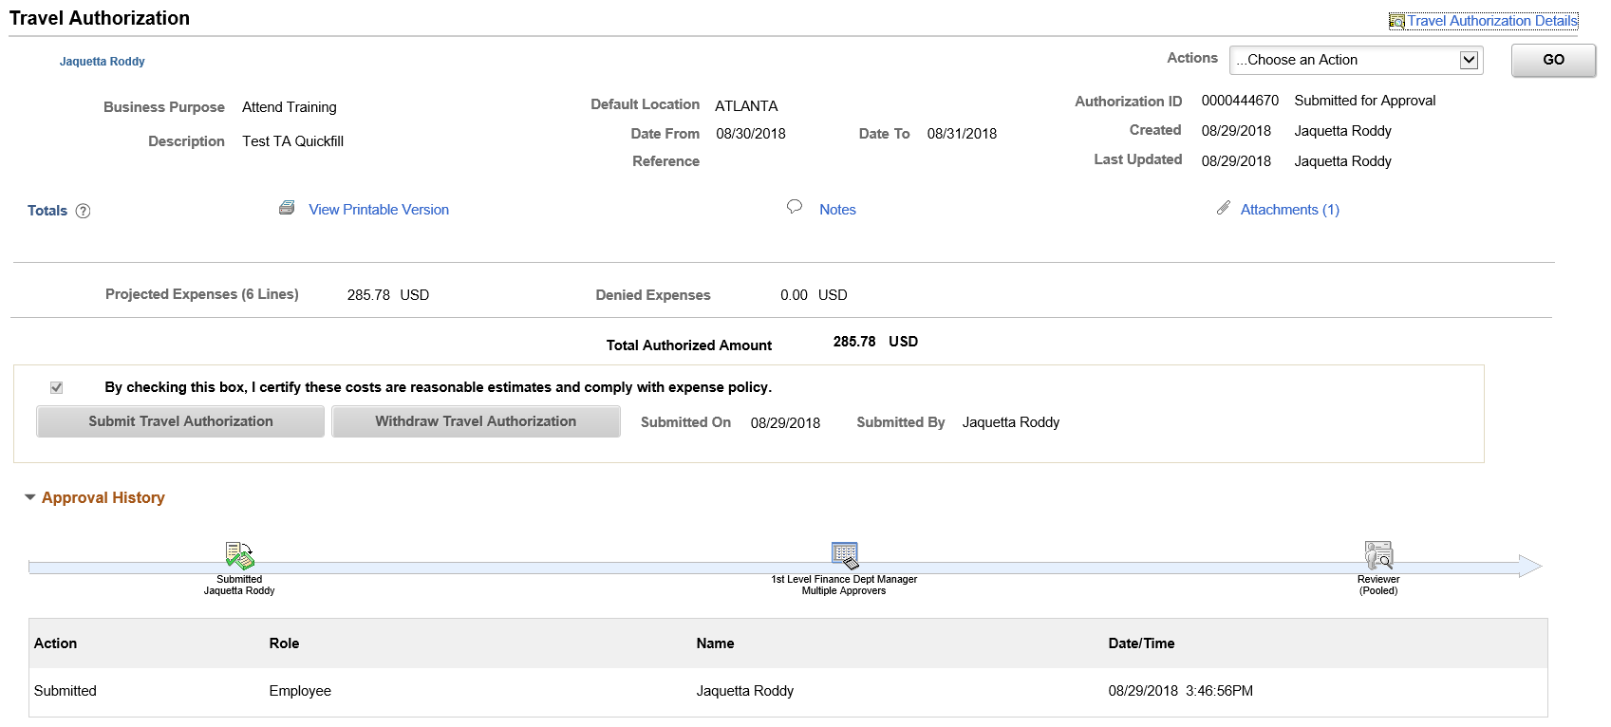
New Classic Plus Pages – View Travel Authorization

Slide 7
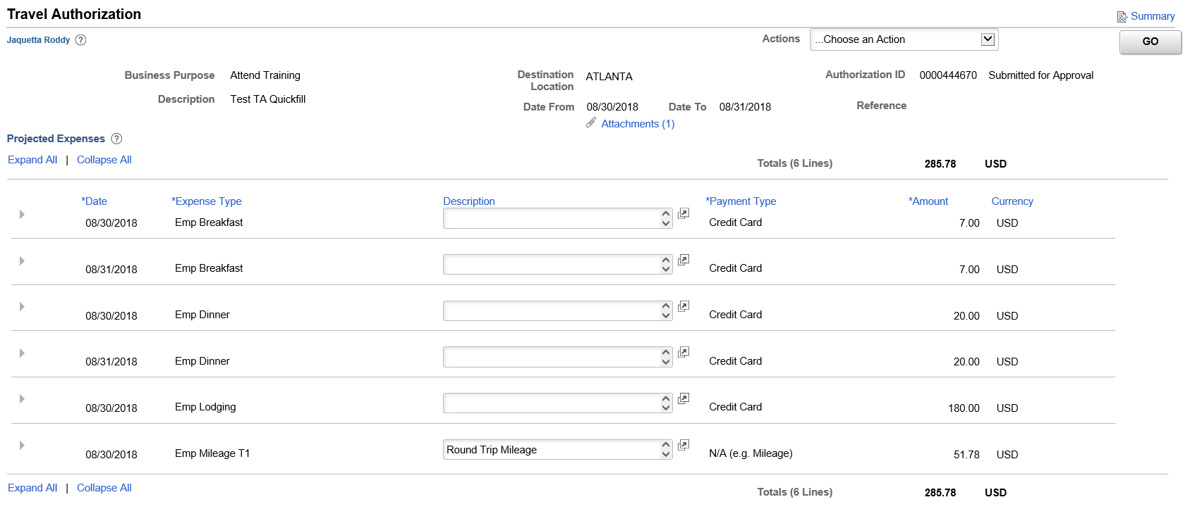
New Classic Plus Pages – View Travel Authorization

Slide 8
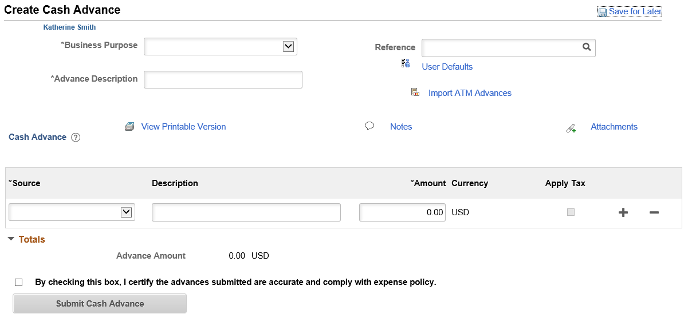
New Classic Plus Pages – Create Cash Advance

Slide 9
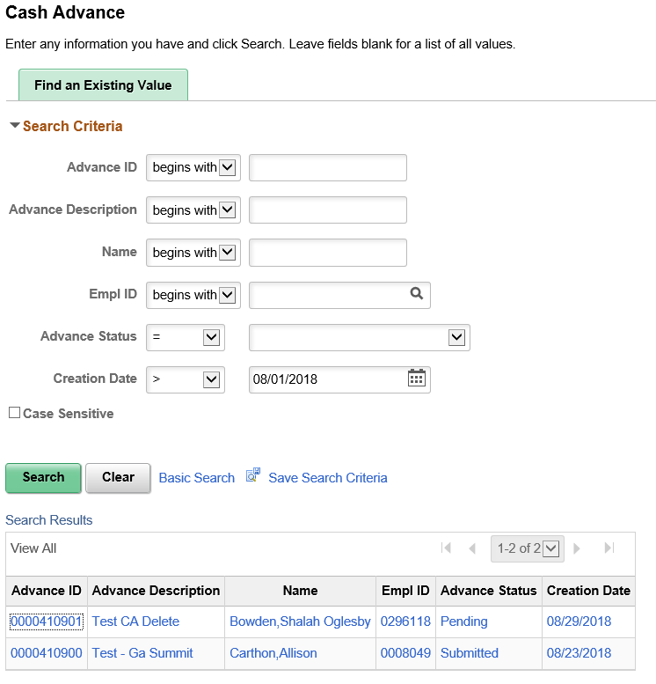
New Classic Plus Pages – View Cash Advance

Slide 10
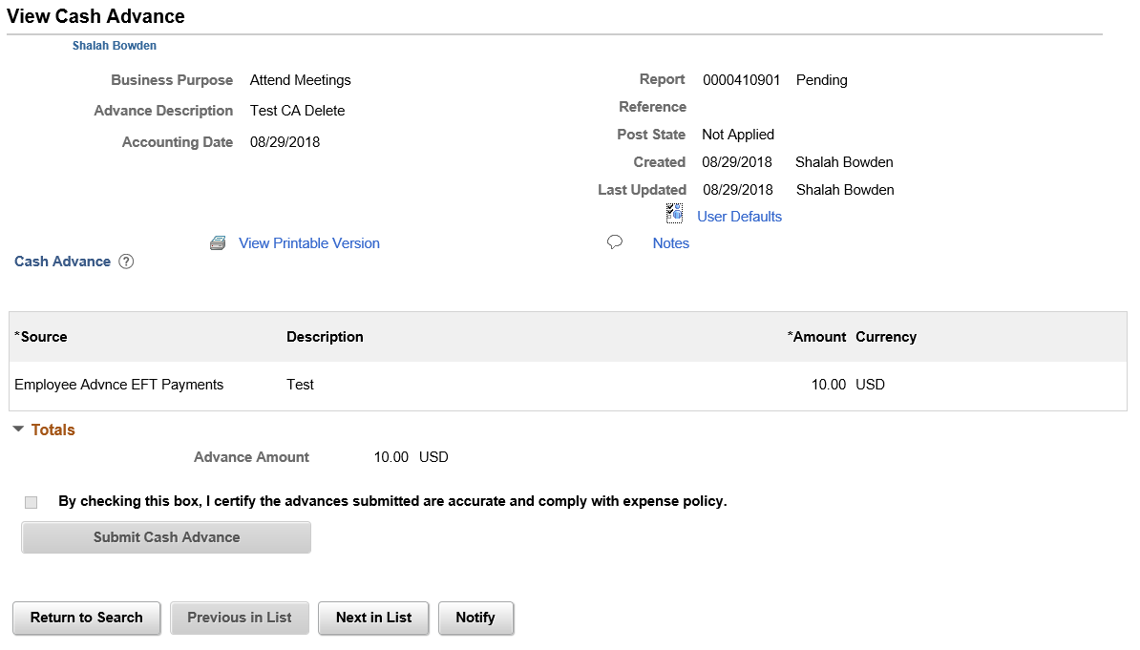
New Classic Plus Pages – View Cash Advance

Slide 11
New Classic Plus Pages – Create Expense Report
Classic Classic Plus

Slide 12
New Classic Plus Pages – Print Expense Report

Slide 13
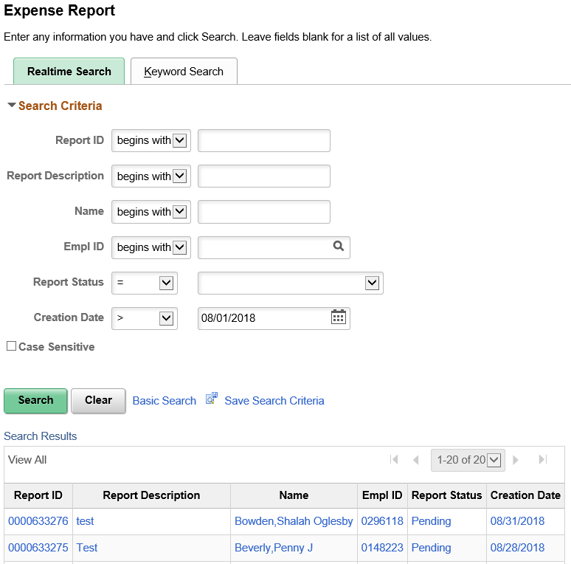
New Classic Plus Pages – View Expense Report

Slide 14
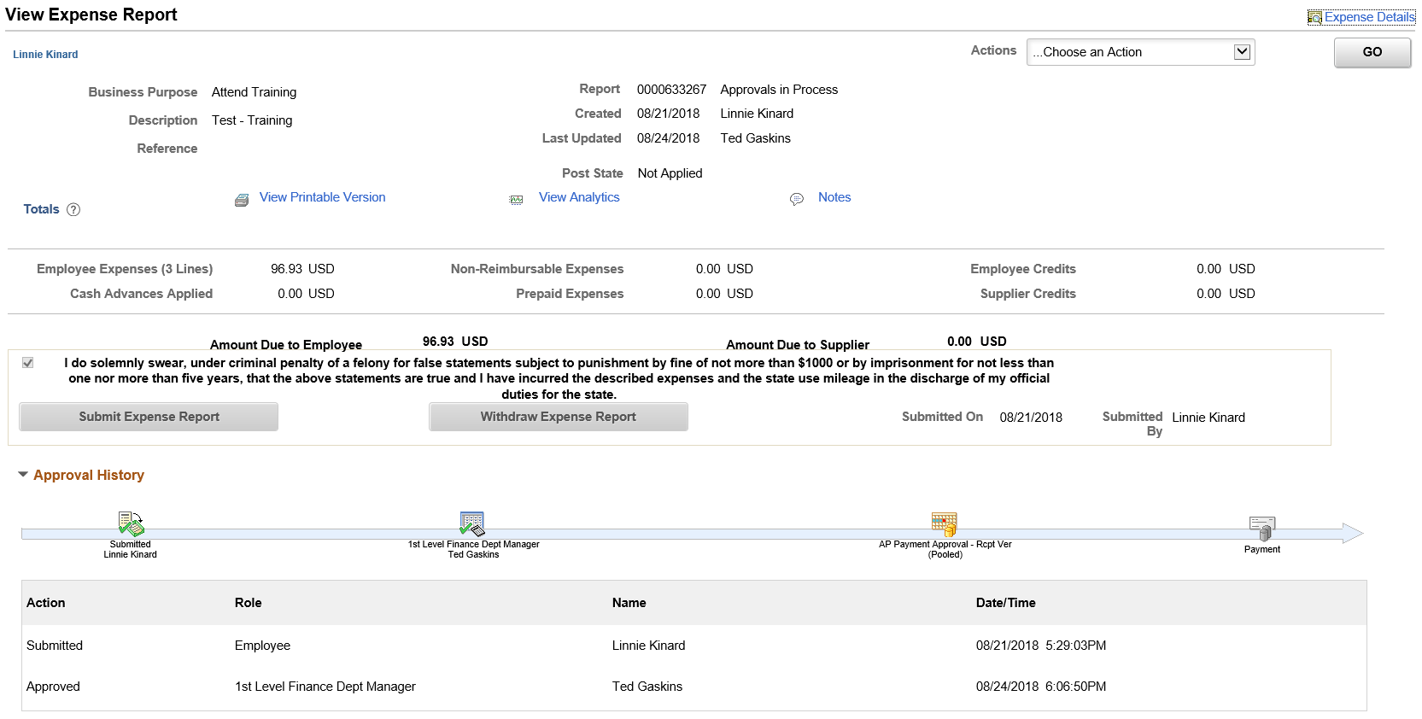
New Classic Plus Pages – View Expense Report

Slide 15
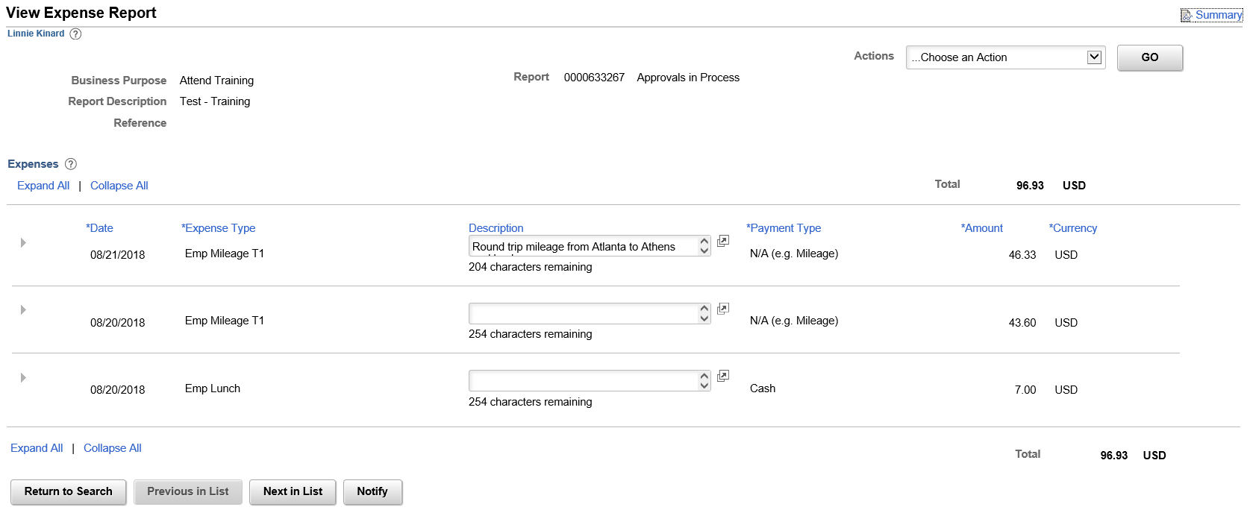
New Classic Plus Pages – View Expense Report

Slide 16
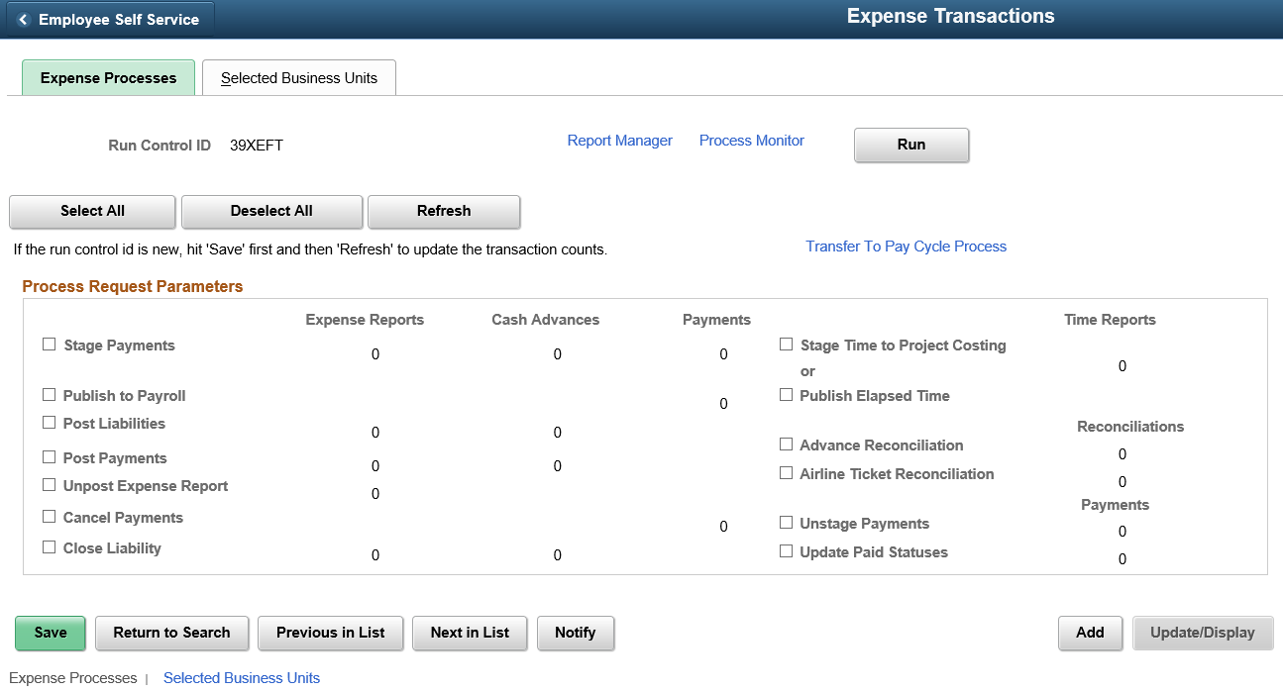
New Classic Plus Pages – Expense Processing

Slide 17
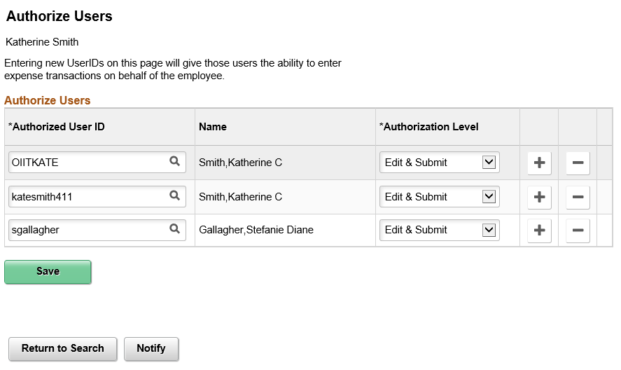
New Classic Plus Pages – Authorize Expense Users

Slide 18
New Classic Plus Pages – Reassign Approval Work

Slide 19
Annual Maintenance Release Preparation
Fully approve OR send back all transactions
No transactions should be in workflow

Slide 20
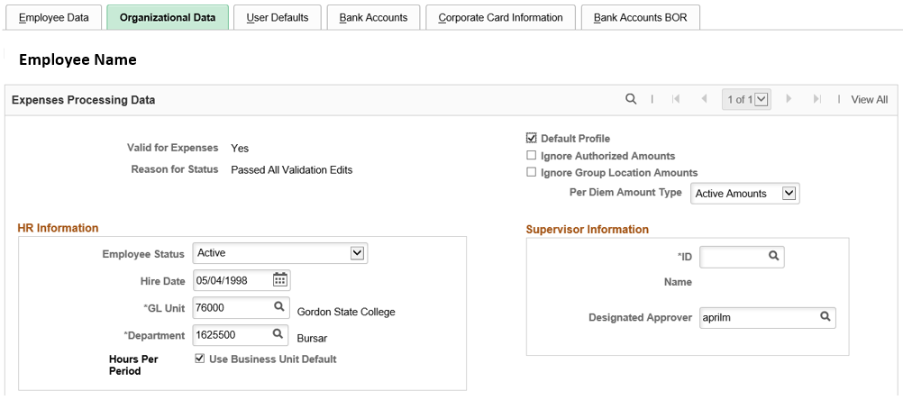
New Query BOR_EX_DESIGNATED_APPROVERS
Returns all employees with a Designated Approver. Available now in FPROD.

Slide 21
How does the process flow for Travel and Expense payments interact with Accounts Payable?

Slide 22
Expense Report Payment Process

Slide 23
How to Void an Expense payment and reissue to a different bank account or as a check

Slide 24
Expense Report Void/Reissue Payment Process

Slide 25
Accounts Payable Voids/Reissues Payment
Accounts Payable > Payments > Cancel/Void Payments > Payment Cancellation

Slide 26
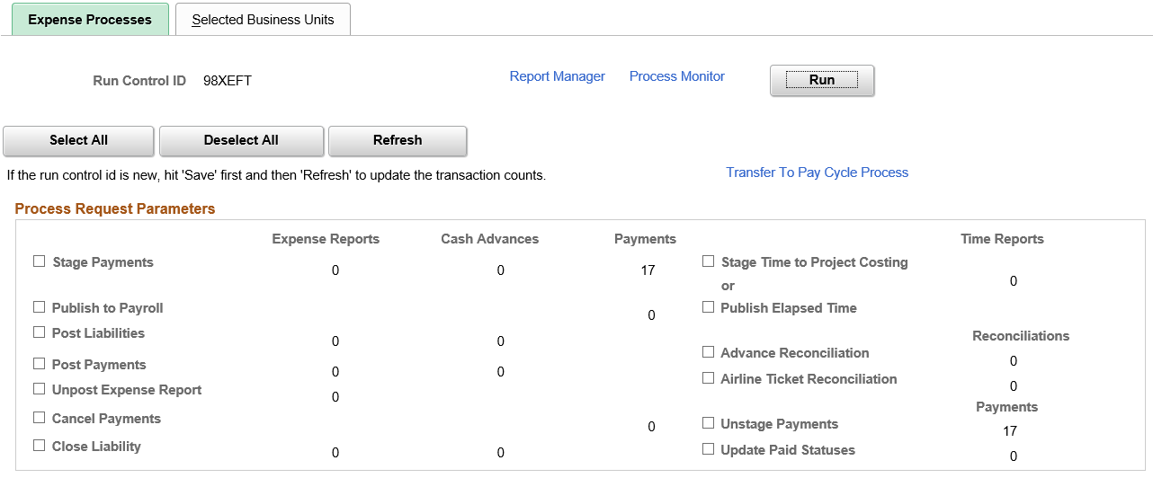
Run Cancel Payments in Expense Processing
Travel and Expenses > Process Expenses > Expense Processing
Status changes from Paid back to Staged
CANCEL accounting entries are created

Slide 27
Expense Administrator changes Payment Method or confirms correct Bank Account
Travel and Expenses > Manage Employee Information > Update Profile
If switching to a System Check, change Payment Method to System Check

Slide 28
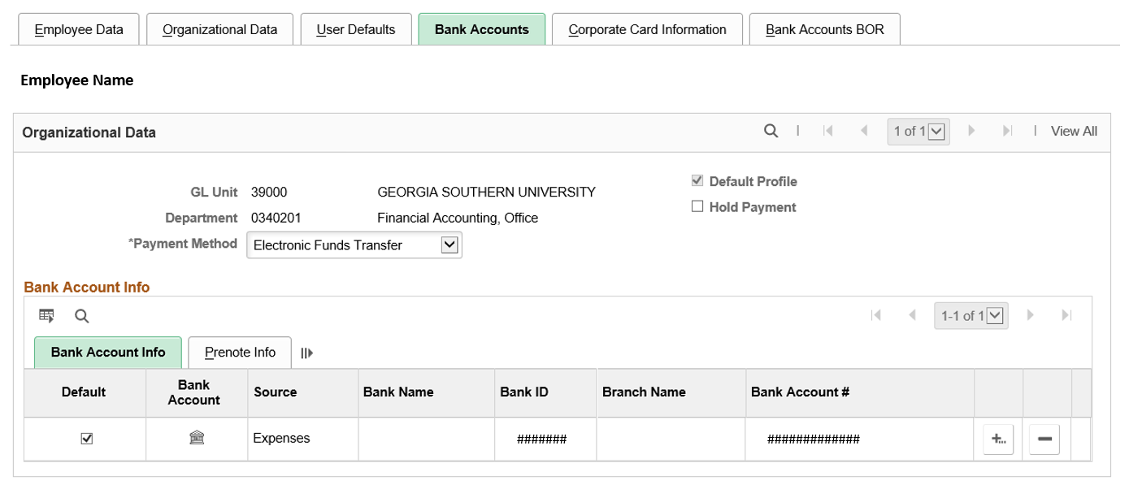
Expense Administrator changes Payment Method or confirms correct Bank Account
If issuing to a new bank account, verify the new account is present on the Bank Accounts tab

Slide 29
Run Unstage Payments

Slide 30
Run Stage Payments
Stage Payments creates NEW payment information so your Expense payment will generate to the new bank account or as a System Check

Slide 31
Accounts Payable Runs Pay Cycle and reissued payment is generated

Slide 32
BOR_EX_DUE and the Trial Register Report
Occasional instances of employees not showing on the BOR_EX_DUE query or the Trial Register Report
Run BOR_AP_PAYMENT_REGISTER query and see if they display
Report to ITS
What supporting documentation do you use for your pay cycles?

Slide 34
What status must an Expense Report or Cash Advance be in to successfully pick up in a pay cycle?
Approved
Staged
Submitted

Slide 35
What status must an Expense Report or Cash Advance be in to successfully pick up in a pay cycle?
Approved
Staged
Submitted

Slide 36
Once Accounts Payable Voids/Reissues an Expense payment, what must be done in Expense Processing to re-stage the transaction so it will reissue in another pay cycle?
Run Cancel Payments
Run Stage Payment

Slide 37
Once Accounts Payable Voids/Reissues an Expense payment, what must be done in Expense Processing to re-stage the transaction so it will reissue in another pay cycle?
Run Cancel Payments
Run Stage Payment

Slide 38
In order to change the payment method of an Expense payment, after Accounts Payable Voids/Reissues and Cancel Payments is run in Expense Processing, the payment must be unstaged and then restaged.
True
False

Slide 39
In order to change the payment method of an Expense payment, after Accounts Payable Voids/Reissues and Cancel Payments is run in Expense Processing, the payment must be unstaged and then restaged.
True
False

Slide 40
Questions?

